Slide 1
Neurosonology as a Critical Tool in Critical Care
Alexander Razumovsky, PhD, FAHA
Sentient NeuroCare/SpecialtyCare
Hunt Valley, MD, USA
Alexander.Razumovsky@specialtycare.net

Slide 2
Disclosure
I have the following financial interest or relationship to disclose:
A. Razumovsky, PhD, FAHA is FTE for the private practice (Sentient NeuroCare Services, Inc/SpecialtyCare)
Notes:
Faculty Disclosure information must be included at the top of the activity. Learners must be given enough time to read the information. If time permits, it’s best to have the faculty verbally disclose the information as well. If the faculty member has nothing to disclose – that too must be disclosed – see point 6 above on the slide. This information helps provide the learner with the opportunity to make a determination if they feel the content of the activity will be presented fairly, in an unbiased manner.
The above information included on the slide supports the following standards from The Standards For Commercial Support:
STANDARD 6.Disclosures Relevant to
Potential Commercial Bias
Relevant financial relationships of those with control over
CME content
6.1 An individual must disclose to learners any
relevant financial relationship(s), to include the
following information:
• The name of the individual;
• The name of the commercial interest(s);
• The nature of the relationship the person
has with each commercial interest.
6.2 For an individual with no relevant financial
relationship(s) the learners must be informed
that no relevant financial relationship(s) exist.

Slide 3
Learning Objectives
Describe clinical utility of TCD ultrasonography to diagnose and monitor onset of cerebral vasospasm and abnormally elevated intracranial pressure that are frequently present in the Critical Care
Define the most current information and specific TCD clinical applications for moderate and severe TBI patients in the Critical Care
Analyze the clinical usefulness of the TCD evaluation for patients with cryptogenic stroke and fat embolism symptoms

Slide 4
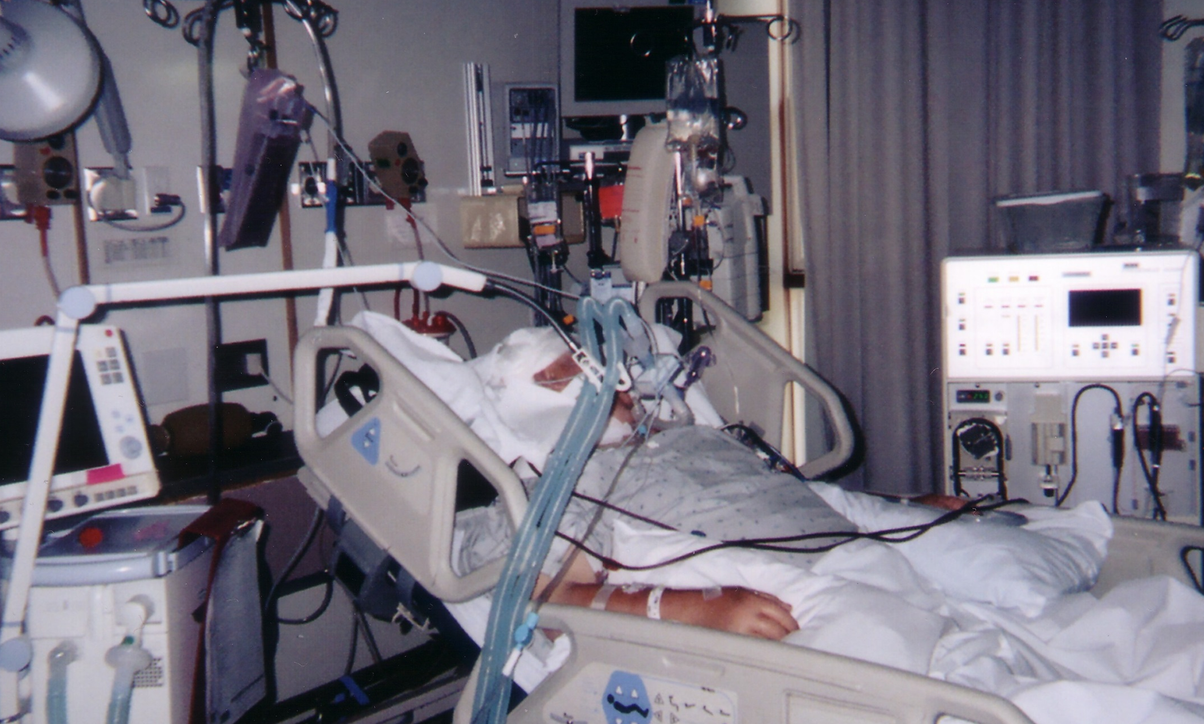
I hope someone is monitoring my brain…
Multimodality monitoring including clinical and laboratory evaluation, imaging, and continuous physiologic data is an important feature of NeuroCritical Care

Slide 5
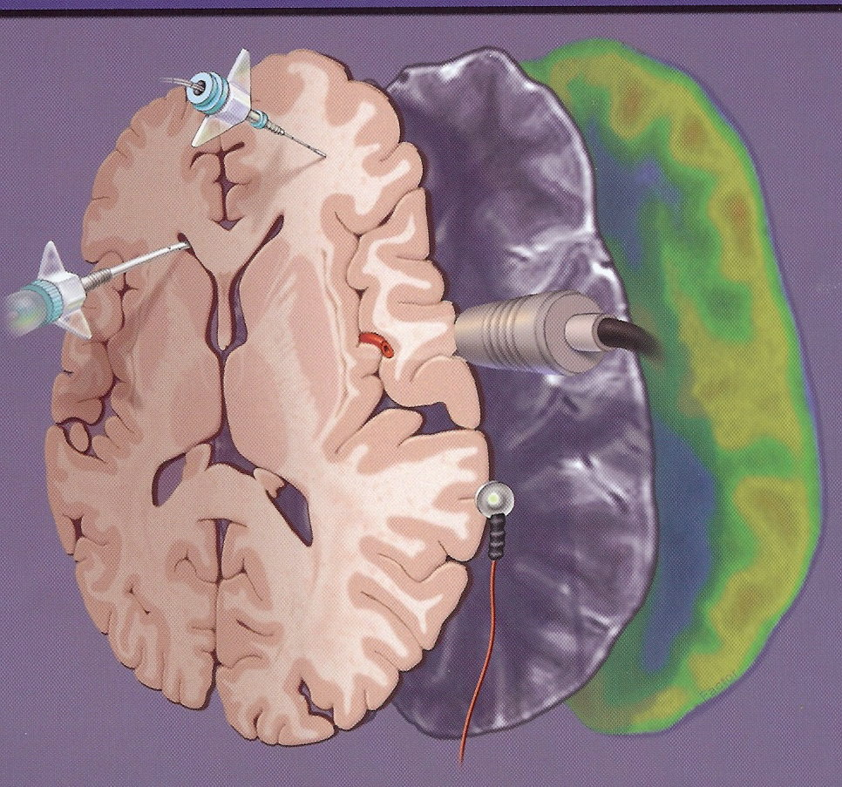
Multimodality Monitoring
MAP
SaO2
ECG
Et-CO2
CVP
Urine output
ICP
CBFV/TCD
PbO2
cEEG
CT/MRI Perfusion

Slide 6
Consensus Summary Statement of the International
Multidisciplinary Consensus Conference on Multimodality
Monitoring in Neurocritical Care
Le Roux P et al, Neurocritical Care, 2014
Neurocritical care depends, in part, on careful patient monitoring but as yet there are little data on what processes are the most important to monitor, how these should be monitored, and whether monitoring these processes is cost-effective and impacts outcome
The use of monitoring modalities has become routine despite limited level I evidence to support their use
It is difficult to demonstrate that any single monitor or combination of monitors has a positive effect on outcome, since outcome is influenced by the therapeutic plan driven by monitoring, not by monitoring itself
Small, randomized studies that focus on intermediate outcomes or biomarker outcomes seem to be a reasonable approach although careful observational studies can also help advance understanding of physiology

Slide 7
Consensus Summary Statement of the International
Multidisciplinary Consensus Conference on Multimodality
Monitoring in Neurocritical Care
Le Roux P et al, Neurocritical Care, 2014
ESSENTIAL REMARK:
No one of currently used monitoring methods in NCCU or SICU was shown improved outcomes in double-blinded prospective trials
However, multimodality monitoring including clinical and laboratory evaluation, imaging, and continuous physiologic data is an important feature of neurocritical care

Slide 8
Specific TCD Applications for Neuro-Critical Care
Vasospasm diagnosis, monitoring and treatment effect evaluation after SAH, TBI, intracranial hemorrhage, tumor resection, etc.
Acute stroke diagnosis, monitoring and treatment effect evaluation
PFO screening for cryptogenic stroke and risk assessment
Emboli and Fat emboli monitoring
CEA/CAS effect evaluation
Neuroradiology test-occlusion (pre, during and post)
Neuroradiology stenting (pre, during and post)
Pre- and post-treatment AVM evaluation
Septic patients evaluation
Diagnosis and monitoring of intracranial hypertension
Total cerebral circulation cessation/brain death clinical diagnosis confirmation

Slide 9
Role of TCD: Post SAH vasospasm
It is useful to perform TCD test on admission (or ASAP after surgery) and perform daily TCD studies when patient is in the ICU
The frequency with which TCD should be performed may be guided by patient clinical presentation, knowledge of risk factors for vasospasm, early clinical course
TCD studies should be performed after endovascular treatment to identify patients with recurrent vasospasm

Slide 10
Role of TCD: Post SAH vasospasm
In symptomatic patients, elevated CBFV’s most likely represent significant vessel narrowing and may obviate the need for cerebral angiography
Asymptomatic patients w/o elevated CBFV’s probably can avoid additional angiography. However, we need to consider patient’s age because elderly patient’s could develop vasospasm in normal or slightly abnormal CBFV’s range

Slide 11
Role of TCD: Post SAH vasospasm
The presence and temporal profile of CBFV’s in all available vessels must be detected and serially monitored
The pattern of CBFV’s elevation may indicate the need to follow patient carefully for evidence of deficits related to specific vascular territory
Waveform appearance either regionally, or globally may be clinically significant

Slide 12
Traumatic brain injury

Slide 13
Traumatic Brain Injury (TBI) Scope
Every 21 seconds, one person in the US sustains TBI
An estimated 5.3 million Americans – little more than 2% of the US population – currently live with disabilities resulting from brain injury
Each year, 80,000 Americans experience the onset of long-term disability following TBI
Annual Costs of TBI in the USA: it is estimated that the cost of TBI weighs in at $48.3 billion annually
US Center for Disease Control (CDC): acute care and rehabilitation of TBI patients in the USA costs about $9 billion to $10 billion per year
Lifetime Cost of Brain Injury: it is estimated that the cost of caring for a survivor of severe TBI is between $600,000 and $1,875,000 over a lifetime

Slide 14
Tbi pathophysiology

Slide 15
BRAIN
EDEMA
Decrease in CBF
More Brain Ischemic Blood Vessels
Edema brain cells Dilate
Cell Injury
Increased ICP

Slide 16
TBI: Pathophysiology
Primary Injury:
- Contusions/Hemorrhages
- Diffuse Axonal Injury (DAI)
  Secondary Injury (Intracranial) occurs hours to weeks/years after injury:
- Blood Flow and Metabolic Changes
- Cerebral Ischemia
- Traumatic Hematomas
- Hydrocephalus
- Cerebral Edema/Increased Intracranial Pressure/Herniation
- PTSD

Slide 17
Post tbi vasospasm

Slide 18
Clinical Significance
The reported incidence of traumatic vasospasm ranges from 19%-68%, the true incidence remains unknown due to variability in protocols for its detection (Kramer et al, 2013)
Extrapolation of current data suggests that as many as 279,000 to 1.2 million patients a year may suffer from post-TBI vasospasm in the USA and 10,800 to 40,000 might experience a resultant clinical decline (W. Rutland-Brown et al, 2006)
Ischemic symptoms accompanying arterial vasospasm following tSAH are comparable to those found following aneurysmal SAH

Slide 19
Comparative Effectiveness of Neuroimaging on the Detection of TBI
DoD Report to US Congress in 2012
MRI, CT, SPECT, PET and TCD
Relevant team of subjects matter experts were identified and 491 sources were recognized and reviewed
In this Report only CT and TCD have high clinical utility* for moderate and severe TBI
* “high clinical utility” indicates that the technique has high clinical applicability for a given severity of TBI

Slide 20
Cerebral Hemodynamic Changes After
Wartime Traumatic Brain Injury
Razumovsky et al, Acta Neurochirurgica, 2013
90 patients with moderate to severe TBI were investigated with daily TCD studies and a comprehensive TCD protocol, and published diagnostic criteria for vasospasm and increased ICP were applied
TCD signs of mild, moderate, and severe vasospasms were observed in 37%, 22%, and 12% of patients, respectively
TCD signs of intracranial hypertension were recorded in 62.2%
These findings demonstrate that cerebral arterial vasospasm and intracranial hypertension are frequent and significant complications of combat TBI; therefore, daily TCD monitoring is recommended for their recognition and subsequent management

Slide 21
A Review of the Effectiveness of Neuroimaging Modalities for the Detection of Traumatic Brain Injury
Amyot et al, J Neurotrauma, 2015
CT, MRI, and TCD were determined to be the most useful modalities in the clinical setting, no single imaging modality proved sufficient for all patients due to the heterogeneity of TBI
TCD is an important tool for monitoring the natural course of TBI, evaluating the effect of medical treatment or intervention, forecasting, and identifying high-risk patients after TBI
Despite a lack of good prospective data on TCD evaluation and outcome in TBI patients, TCD as a noninvasive, inexpensive, and simple procedure that should be engaged in the daily management of TBI patients

Slide 22
Transcranial Doppler to Predict Neurologic Outcome after Mild to Moderate TBI
Bouzatt et al, 2016
A prospective observational study across 17 sites. TCD was performed upon admission in 356 patients with GCS from 9 to 15 with mild lesions on CT. Normal TCD was defined as a PI of less than 1.25 and diastolic CBFV higher than 25 cm/s in the two MCAs. The primary endpoint was secondary neurologic deterioration on day 7
Results: Twenty patients (6%) developed secondary neurologic deterioration within the first posttraumatic week. TCD thresholds had 80% sensitivity and 79% specificity to predict neurologic worsening. The NPV and PPV of TCD were 98% and 18%, respectively. In patients with mTBI (GCS, 14 to 15), the sensitivity and specificity of TCD were 91% and 80%, respectively. Patients with abnormal TCD on admission (24%, 86 patients) showed a more altered score for the disability rating scale on day 28 compared to those with normal TCD (257 patients).
Conclusions: TCD measurements upon admission may provide additional information about neurologic outcome after mild to moderate traumatic brain injury. This technique could be useful for in-hospital triage in this context.

Slide 23
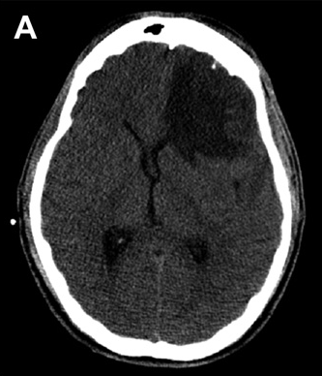
25 yo patient after blunt TBI, no blood was detected by CT and MRI

Slide 24
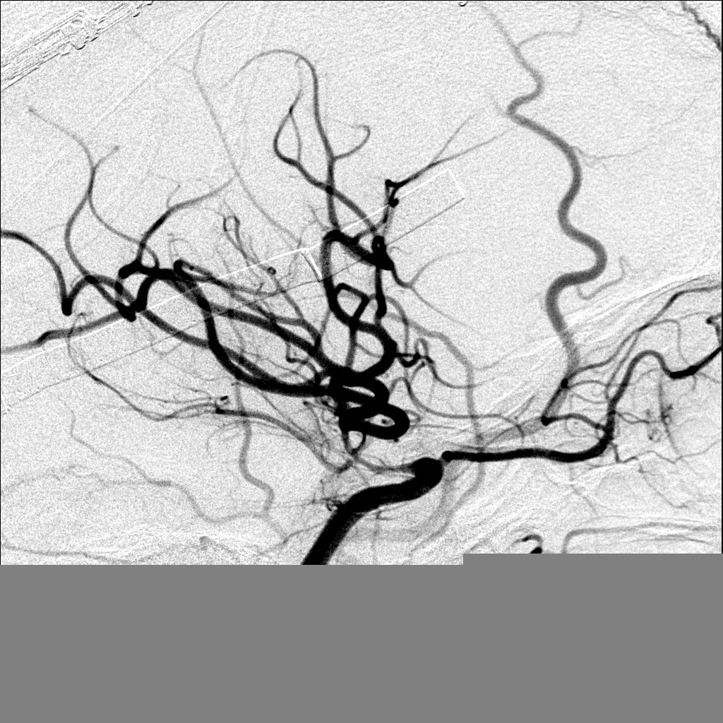
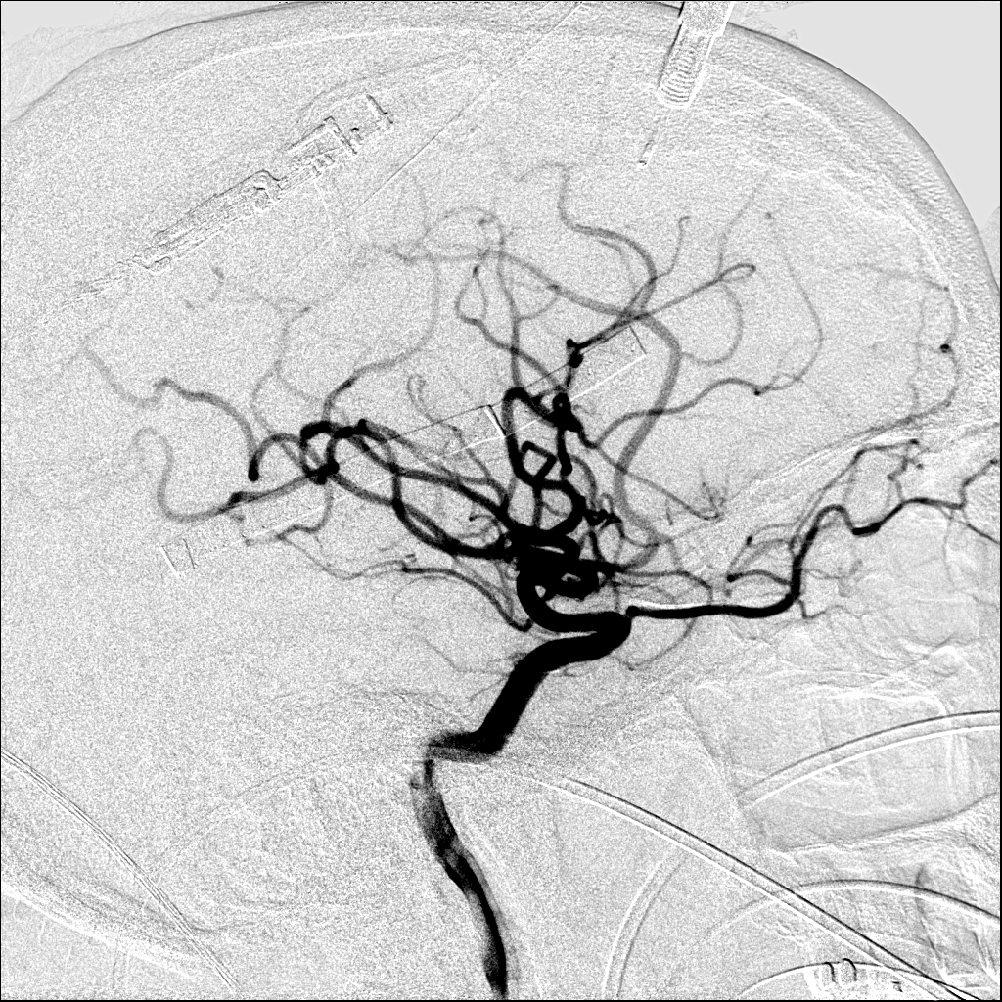
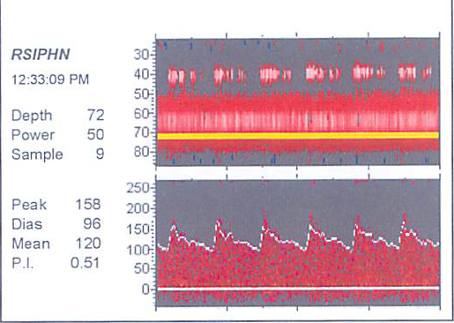
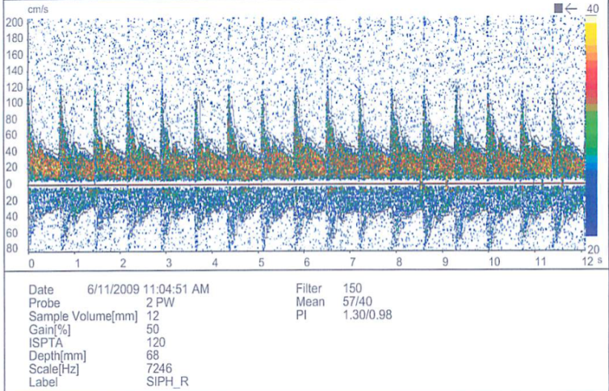
25 yo, closed TBI, no SAH
CBFV 120 cm/s CBFV 57 cm/s

Slide 25
Role of TCD: Post TBI vasospasm
The incidence of vasospasm after TBI is similar to that following aneurysmal SAH but seems also could start later (up to 10 days) and be longer
Because vasospasm is a significant event in a high proportion of patients after TBI, close TCD monitoring is recommended for the treatment of such patients

Slide 26
Post-tbi intracranial hypertension

Slide 27
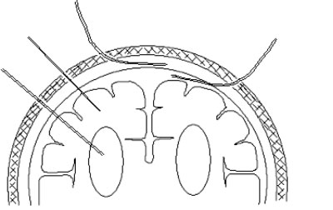
ICP Monitoring Methods
IV catheter “Gold Standard”
- Most invasive method
- High infection rate
- May be difficult to insert
- Simultaneous CSF drainage and ICP monitoring not possible
I/P Probe
- Measures local pressure
- Drift of zero over time
ED
SA
IP
IV
ED Probe
- Limited accuracy
- Relatively delicate
SA Probe
- Limited accuracy
- High failure rate
- Periodic flushing necessary

Slide 28
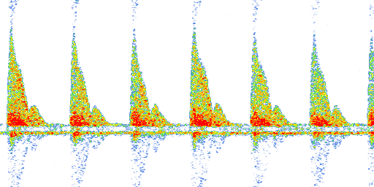
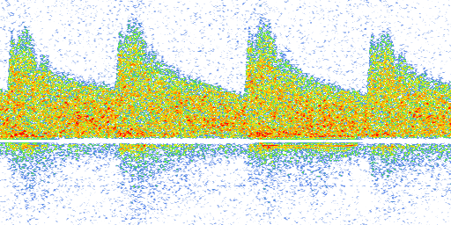
Typical morphology of TCD wave-form
MCA (M1 and M2 segm)
ICA (C1, C3 and C4 segm)
ACA (A1 segm)
PCA (P1, P2 segm)
VA’s and BA
Low peripheral resistance/Low PI
OA
High peripheral resistance/High PI

Slide 29
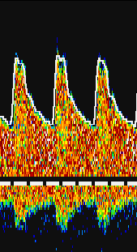
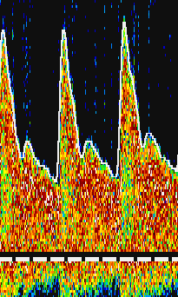
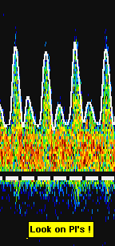
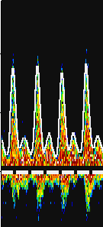
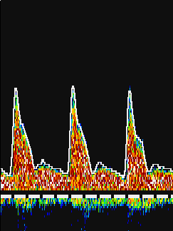
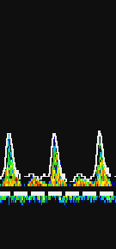
TCD wave-form changes with development of intracranial hypertension
Moreno et al, 2000; Belner et al, 2004; et al, 2005; Splavski et al, 2007;
Melo et al, 2011; de Riva et al, 2012 and many, many others
PI > 1.25 (Bouzat et al, 2011, 2016)
PI ≥ 1.26 could reliably predict CSF-P ≥ 20 cm H2O or 14.7 mmHg (Wakerley et el, 2015)
ICP 20 mm Hg and higher
Normal ICP

Slide 30
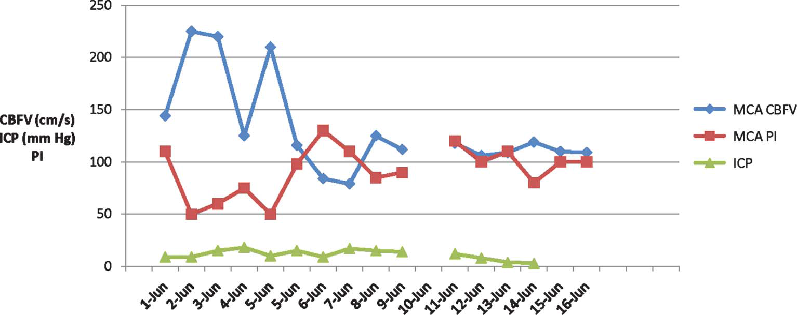
Patient with GSW
Trend shows almost direct inverse relationship between CBFV and PI but epidural ICP values normal
Razumovsky et al, Neurosurgery, 2011

Slide 31
TCD and ICP
Numerous data shows a highly significant correlation between TCD measured PI and ICP independent of intracranial pathology
In patients with suspected increase in ICP or where an increased ICP has to be excluded, PI may be of guidance and repeated PI measurements might prove a useful tool in ER, Neuro-ICU care or out-patient settings
In emergency situations TCD measured PI can be used alone when ICP monitoring is contraindicated or not readily available

Slide 32
TCD PI in the management of TBI
PI measurements permit the early identification of patients with low CPP/high ICP and great risk of cerebral ischemia
In emergency situations it can be used alone when ICP monitoring is contraindicated or not readily available

Slide 33
Role of TCD: Intracranial hypertension evaluation
TCD wave-form changes indicates abnormally high ICP, especially after 20 mm Hg
TCD changes may alarm Neuro-ICU personnel and may indicate malfunctioning of ICP probe
Abnormally globally decreased pattern of the CBFV’s in parallel with increased PI’s indicate onset of diffuse intracranial hypertension
Sudden onset of asymmetrical CBFV’s and PI’s changes may indicate potential mid-line shift
TCD quantitative and qualitative analysis must be taken into account for evaluation of intracranial hypertension, however, MAP, PaCO2 and cardiac output must be within the normal limits

Slide 34
Non-Invasive ICP monitoring would enable
Triage at the point of contact
Battlefield, football field, ambulance, ER…
In-time and evidence‐based application of therapy
Titrate therapy to ICP targets
Long‐term monitoring
Without the risk of infection or damage to vital brain structures
Expansion of patient pool for which monitoring might be beneficial
Mild and moderate TBI, migraines, pediatric patients,…

Slide 35
Role of TCD: Traumatic Brain Injury
CBFV’s often increased in patients with TBI due to the posttraumatic vasospasm
TCD waveform changes can signal significant ICP changes
TCD is valid in predicting the patient’s outcome

Slide 36
Pfo diagnosis: contrast tcd or contrast tte/tee?

Slide 37
PFO Diagnosis:
Contrast-TCD vs. c-TTE or c-TEE?
No such question any more!

Slide 38
Transcranial Doppler versus transthoracic echocardiography for the detection of patent foramen ovale in patients with cryptogenic cerebral ischemia: A systematic review and diagnostic test accuracy meta-analysis
Katsanos AH et al, Ann Neurology, 2016
OBJECTIVE: PFO can be detected in up to 43% of patients with cryptogenic cerebral ischemia undergoing investigation with TEE. The diagnostic value of TTE in the detection of PFO in patients with cryptogenic ischemic stroke or transient ischemic attack has not been compared with that of TCD using a comprehensive meta-analytical approach
METHODS: We performed a systematic literature review to identify all prospective observational studies of patients with cryptogenic cerebral ischemia that provided both sensitivity and specificity measures of TTE, TCD, or both compared to the gold standard of TEE
RESULTS: Our literature search identified 35 eligible studies including 3,067 patients. The pooled sensitivity and specificity for TCD was 96.1% and 92.4%, whereas the respective measures for TTE were 45.1% and 99.6%. TTE was superior in terms of higher positive likelihood ratio values whereas TCD demonstrated lower negative likelihood values compared to TTE. Finally, the area under the summary receiver operating curve (AUC) was significantly greater (p < 0.001) in TCD compared to TTE studies
INTERPRETATION: TCD is more sensitive but less specific compared to TTE for the detection of PFO in patients with cryptogenic cerebral ischemia. The overall diagnostic yield of TCD appears to outweigh that of TTE

Slide 39
TCD and TEE
Bubble-TEE
- Sedation
- Not possible to perform in patients with swallowing difficulties
- Involves many specialists, expensive equipment
Global Fee $1,400.00
Bubble-TCD is the cost-effective and minimally invasive compared to bubble-TEE
Direct demonstration of embolism through a PFO to the cerebral circulation has been demonstrated
Global Fee $219.00

Slide 40
Consensus Statement
Cerebrovasc Dis, 2000
A 4-level categorization was accepted according microemboli appearance using unilateral MCA monitoring:
No occurrence of microemboli
1-10 microemboli
>10 microemboli but no curtain
curtain or shower where a single microemboli cannot be discriminated within the TCD spectrum

Slide 41
Power M-Mode Transcranial Doppler for Diagnosis of Patent Foramen Ovale and Assessing Transcatheter Closure
Spencer at al., 2004
To grade RLS, a 6-level logarithmic scale was used for both resting and Valsalva injections as follows:
Grade 0 =0 ETs,
Grade I = 1-10 ETs,
Grade II = 11-30 ETs,
Grade III =31-100 ETs,
Grade IV = 101-300 ETs,
Grade V > 300 ETs.

Slide 42
Factors influencing number of HITs
The numbers of HITs represented tracers of the conductance of RLS flow to the anterior circulation of the brain. The conductance takes into account many factors including:
The RLS flow distribution to the anterior circulation
of the brain,
The size of the foramen while open
The right-to-left pressure gradient when the foramen is open.
All HITS must be counted visually.

Slide 43
Case Report
Courtesy of Spencer Technologies
This is a 33-year-old-female that had an episode of slurred speech and a moderate headache lasting two minutes in March 2002. She complains of occasional dizziness and had a history of migraine with visual aura since her teenage years. We are asked to evaluate for the presence of a right to left cardiac/pulmonary shunt.

Slide 44
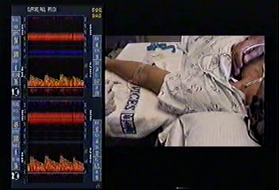
RESTING BUBBLE STUDY
Courtesy of Spencer Technologies

Slide 45
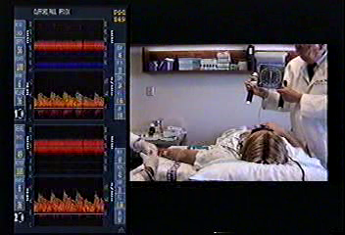
STRAINING BUBBLE STUDY
Courtesy of Spencer Technologies

Slide 46
Fat embolism

Slide 47
Fat Embolism Syndrome (FES)
FES syndrome remains a potentially life threatening complication of long bone fractures. The true incidence is difficult to assess as many cases remain undiagnosed
It varies from 0.5% to 30% of fractured patients with higher rates in multiply injured patients and presents a mean mortality rate of 10%
Manifests 24-72 hours post injury
Cerebral involvement varies from confusion to encephalopathy with coma and seizures. Clinical symptoms and CT are not always diagnostic, while MRI is more sensitive in the detection of a suspected brain embolism

Slide 48
Epidemiology
United States
Frequency is estimated to be 3-4%. Fat embolism is a clinical diagnosis. Many patients are likely to have a missed diagnosis because of subclinical illness or confounding injury or illness
Mortality/Morbidity
The mortality rate of fat embolism is 10-20%. Patients with increased age, multiple underlying medical problems, and/or decreased physiologic reserves have worse outcomes than other patients

Slide 49
FES and PFO
TCD is the unique standard for evaluation of emboli
Cerebral microembolism after long-bone fractures can be detected in vivo and monitored over time. These findings may have potential diagnostic and therapeutic implications
The presence or the reopening of a PFO due to pulmonary hypertension is associated with an increased risk for systemic manifestations of FES

Slide 50
TCD is a Critical Quantitative Tool in Critical Care
The use of TCD at hospital admission allows identification of patients with brain hypoperfusion due to the stroke, vasospasm after SAH/TBI and/or intracranial hypertension
In such high-risk patients, early TCD goal-directed therapy can restore normal cerebral perfusion and might then potentially help in reducing the extent of secondary brain injury
TCD represent effective modality to monitor effects of treatment and interventions

Slide 51
Clinical Value of TCD for Critical Care
Detect a Change from Baseline/Normal Values Early in the Course of Illness and Before Irreversible Damage Occurs
Contributes to the pharmacological management, further diagnostic testing and/or interventional treatment

Slide 52
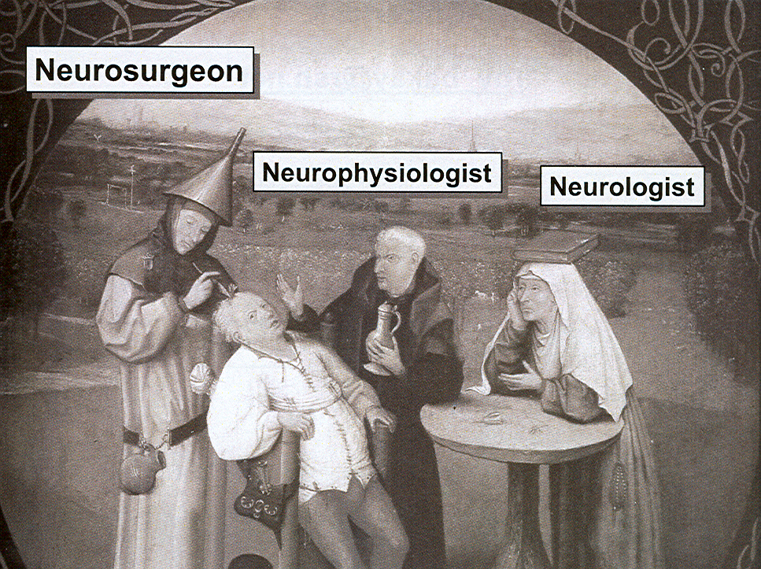
Neurointensivist
IT MUST BE THE TEAM!
MULTIPLE PERSPECTIVES

