Slide 1


Clinical Relevance of Carotid Atherosclerosis Among Egyptians and Role of Neurosonology for Endovascular Treatment of Carotid Lesions
Prof. Foad Abd-Allah
Department of Neurology
Cairo University , Egypt.
foad.abdallah@kasralainy.edu.eg

Slide 2
Disclosure
Nothing to disclose

Slide 3
Learning objective(s)
To identify carotid artery disease as a cause for stroke.
To assess clinical relevance of carotid artery disease.
To use carotid duplex for selection of patients for carotid intervention..
To establish a post carotid intervention surveillance protocol.

Slide 4
Clinical Relevance Of Carotid Atherosclerosis Among Egyptians
Notes:
Few years ago , we raised a research Q ?

Slide 5
  In Egypt, little was known about the prevalence and distribution of carotid disease among the population.
  This hampered preventive measures and promoted us to analyze extra-cranial carotid duplex scans of a large sample of the Egyptians.

Slide 6
Egyptian Carotid Atherosclerosis Study
Notes:
We conducted a retrospective analysis

Slide 7
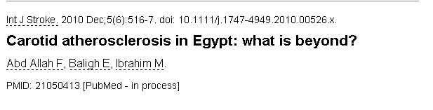
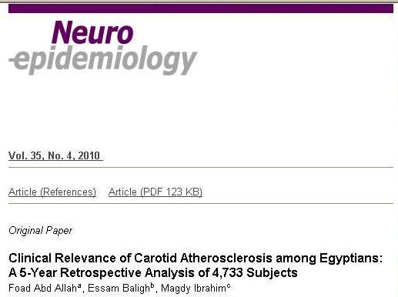
Notes:
This stimulated us to conduct a retrospective analysis among large sample of Egyptian population who performed carotid artery scanning for different purposes

Slide 8
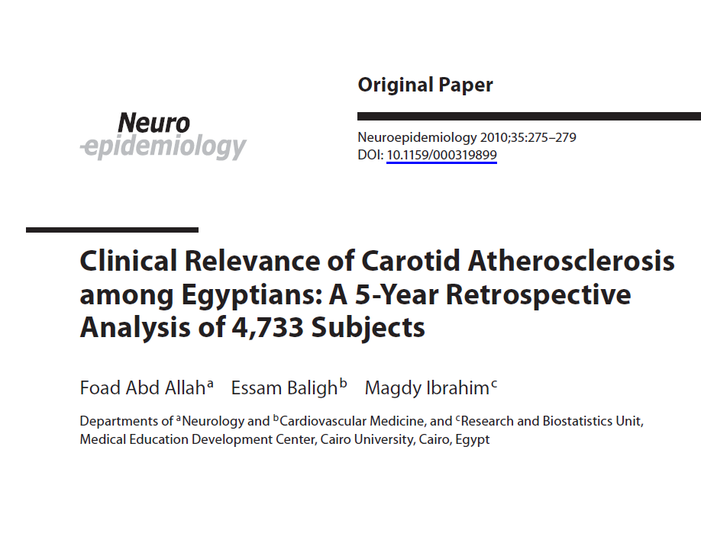
Notes:
Study was published in Neuroepidemiology

Slide 9
  Analysis of the data of 4733 Egyptian subjects, who underwent extra-cranial carotid duplex scanning at the vascular laboratories of Cairo-university hospitals was done from 1.1.2003 to 1.1.2008.
  Demographic, clinical data and causes of referral were correlated with ultrasound findings.
Notes:
Cairo university hospitals are the largest tertiary care center in MENA region with capacity of 5000 beds

Slide 10
    Clinical presentation
  Symptomatic with stroke or transient ischemic attacks (TIAs)
  Asymptomatic and causes of referral were reported in this group.
Clinical Presentation | Number of atherosclerotic (n = 1940) | Percentage
Asymptomatic | 1182 | 60.9%
1. Routine check up | 393 | 20.3%
2. Prior to coronary artery bypass graft | 582 | 30%
3. Follow-up of patients with carotid disease who underwent medical, endovascular or surgical treatment. | 207 | 10.7%
Symptomatic with TIA or stroke | 758 | 39.1 %
Notes:
Asymptomatic cases represented about 60% of the study population , they presented for many reasons like routine check up , high risk population , check up before coronary bypass surgery …………etc

Slide 11
Carotid duplex scan
  Carotid duplex scanning was performed by qualified vascular operators.
  The carotid duplex findings were classified as normal, atherosclerotic or non-atherosclerotic disease.
  The degree of atherosclerotic carotid artery disease was categorized as intimal thickening only, <50% stenosis, stenosis from 50% to 69%, stenosis ≥70% and occlusion.
Notes:
Who performed thousands of cases

Slide 12
  Atherosclerotic carotid disease was present in 1940 subjects (41%) of the study populations

Slide 13
Results of carotid duplex ultrasound scans
Ultrasound Finding | Number of subjects (n = 4733) | Percentage
Normal | 2784 | 58.8%
Atherosclerotic | 1940 | 41 %
Non Atherosclerotic* | 9 | 0.2%

Slide 14
  Clinical data were collected from each individual prior to ultrasound examination as follows:
    Cardiovascular risk factors
 | OR | Lower 95% CI | Upper 95% CI | p value
Age | 1.079 | 1.072 | 1.087 | < 0.001
Male sex | 0.472 | 0.119 | 1.881 | 0.288
DM | 2.019 | 1.727 | 2.361 | < 0.001
HTN | 1.541 | 1.329 | 1.786 | < 0.001
Smoking | 1.835 | 1.575 | 2.139 | < 0.001
Dyslipidemia | 2.073 | 1.429 | 3.006 | < 0.001
Obesity | 0.800 | 0.649 | 0.986 | 0.037
IHD | 1.111 | 0.812 | 1.521 | 0.511
Notes:
It is very clear that vascular risk factors were more prevalent among carotid atherosclerotic group

Slide 15
  Frequency of different degrees of carotid atherosclerosis among symptomatic atherosclerotic subjects
Degree of Atherosclerosis | Symptomatic Atherosclerotic subjects (n = 758) | Percentage
Intimal thickening | 514 | 67.8%
< 50% | 225 | 29.7%
50 - 69% | 6 | 0.8%
≥ 70% | 10 | 1.3%
Occlusion | 3 | 0.4%
Notes:
Out of 1940 subjects (41%) of the study populations What is about the degree of carotid atherosclerosis , the summtion of more than 50% up to occlusion , it is only 2.5 %. The majority of cases are mild atherosclerosis

Slide 16
  The 2.5% prevalence of significant and clinically relevant atherosclerotic carotid disease found was much lower than that noticed in studies from developed countries as America, Europe and Asia.
  An American cohort of 1189 residents of Framingham found hemodynamically significant carotid stenosis (>50%) in 7% of women and 9% of men.
  The Suita Study in Japan detected extracranial carotid stenosis >50% in 4.4% of all the subjects.
  The German Berlin Aging Study, a population-based study of functionally healthy volunteers, found a 4% of ≥75% carotid stenosis among both men and women .

Slide 17
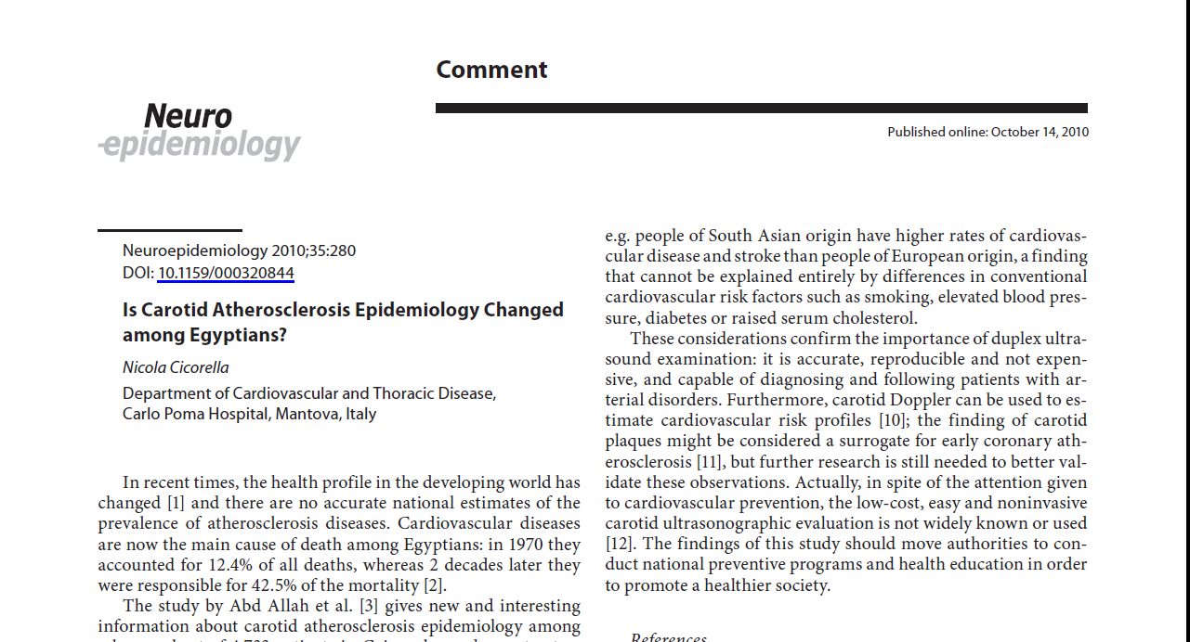
Notes:
Then we received many comments and arguments

Slide 18
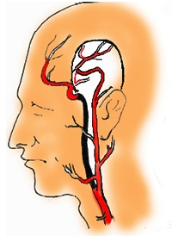




The discrepant prevalence of clinically relevant carotid disease among Egyptians and residents of developed countries raises number of questions:
  Is it genetic?
  Is it the nutritional habits?
  Is it the physical activity?
  Is it the environmental conditions?
  Or is it the higher rate of intracranial atherosclerosis compared to extracranial disease?

Slide 19
The only answer is that the reason was unknown
Notes:
That stimulated us to conduct a serial of studies about ICAD

Slide 20
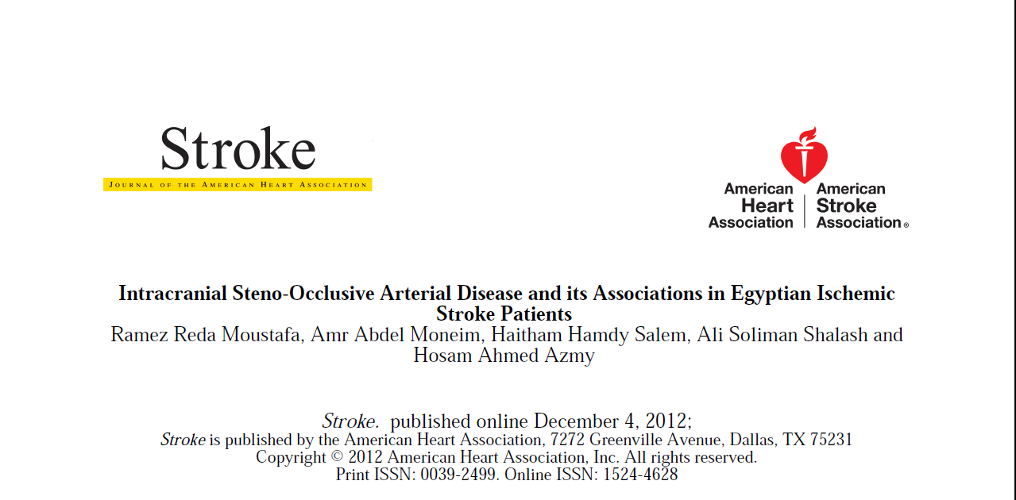

Slide 21
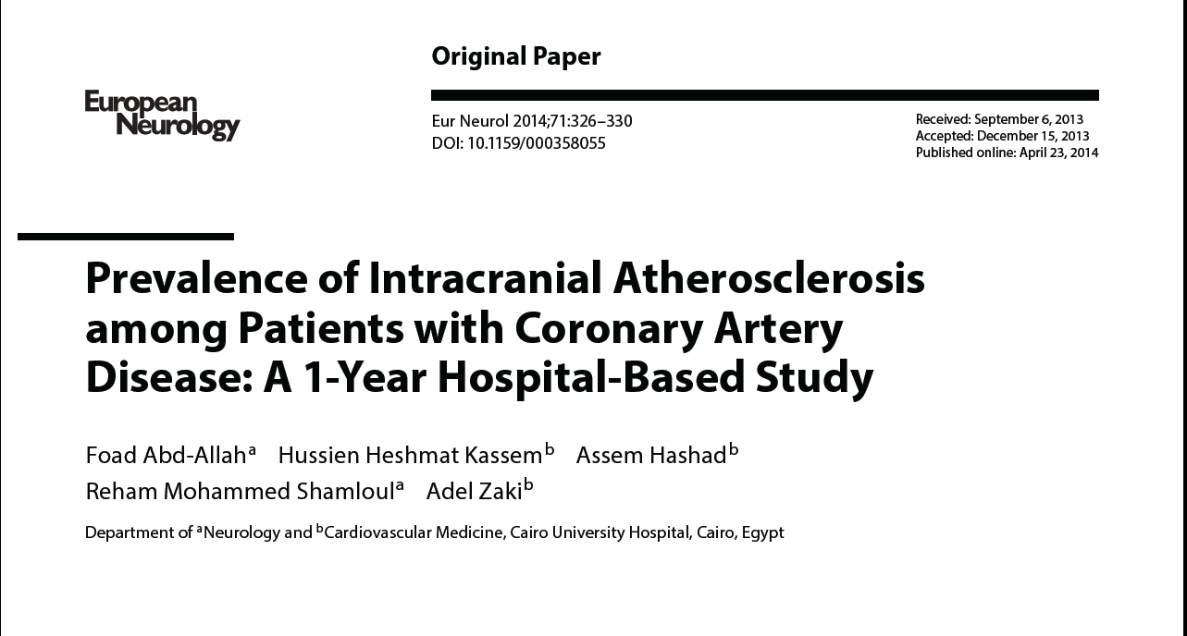

Slide 22
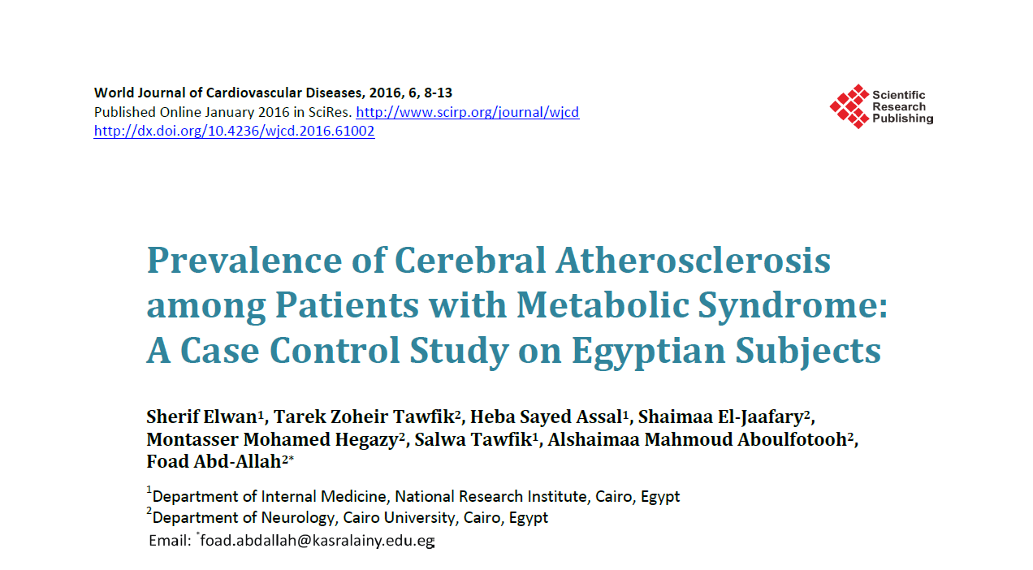

Slide 23
ICAD among Egyptians
  Symptomatic intracranial steno-occlusive disease was detected in (27.3%) of acute ischemic stroke patients.
  The prevalence of asymptomatic intracranial arterial stenosis (ICAD)was(13.1%) in patients with vascular risk factors.
  Intracranial disease was detected in (11.9%) patients who had coronary artery disease (CAD).
Notes:
Here we got the answer Egyptians have more intracranial disease than extracranial

Slide 24
  The possibilities to shift to fast food habits in Cairo are increasing and getting abundant. Atherosclerosis among the next generations of Egyptians might be rising.
  This is a call for health authorities to perform population based epidemiological studies, monitor the non-communicable diseases and invest into health education and prevention programs.

Slide 25
Role Of Neurosonology for Endovascular Treatment of Carotid Lesions

Slide 26
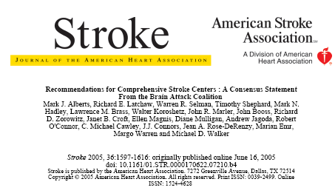
Guidelines to set up comprehensive stroke service
Notes:
Most of the guide lines to establish comprehensive stroke center included non invasive vascular tool .

Slide 27
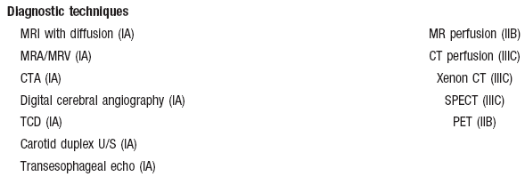
Guidelines to set up comprehensive stroke service
Notes:
Extra & transcranial Doppler sonography were an essential prerequisite for CSC not an optional

Slide 28
Extra and Trans-cranial Ultrasound in different stages of Carotid Intervention
  Carotid Screening.
  Risk prediction.
  Decision Making CAS vs CEA.
  TCD Monitoring during procedure.
  After CAS Surveillance.
Notes:
How the Extra & Transcranial can help . It is an easy, simple non invasive vascular tool to assess for carotid atherosclerosis . Furthermore it can predict the future risk cerebrovascular events . It also help for decision making , monitoring during carotid intervention and most important after an easy waycarotid artery stent follow up and long term monitoring .

Slide 29
Asymptomatic carotid stenosis
  Annual risk of ipsilateral stroke ?
      Risk of stroke in asymptomatic carotid stenosis less than 3% .
  Baseline characteristics that predict the risk of stroke in patients with asymptomatic ICAS:
      High grade: > 80% from the start.
      Vascular risk factors: smoking, CAD, DM, PVD, HTN, Age, increased LDL.
      Unstable ulcerated plaque.
      Presence of inflammatory markers e.g. fibrinogen.
      Presence of micro- embolic signals in TCD monitoring
      Presence of intracranial hemodynamic insufficiency ipsilateral to ICAS.
      Presence of silent brain infarct ipsilateral to ICAS.
      Impaired Neuro-psychological test .
Notes:
We know the risk of stroke in asymptomatic patient with carotid stenosis is very low . Ultrasound assessment can add some parameters that increase the sensitivity of risk prediction .

Slide 30
Symptomatic carotid stenosis
  Annual risk of ipsilateral stroke ?
      The recurrent risk of stroke is 25-30% for high grade symptomatic stenosis.
  Risk of recurrent stroke in patients with recent symptomatic carotid stenosis:
      Degree of stenosis: 50-99%.
      Time from last event: few days-180 day.
      Primarily symptomatic event: major stroke >minor stroke >multiple cerebral TIA >single cerebral TIA> retinal TIA.
      Presence of diabetes, myocardial infarction and peripheral vascular disease.
      Presence of untreated hypertension (>160/90).
      Presence of irregular ulcerated plaque surface.
Model for predicting the risk of ipsilateral ischemic stroke in patients with recent symptomatic carotid bifurcation stenosis.(www.stroke.ox.ac.uk).
Notes:
Computerized based Model designed by Oxford Stroke Research Group involved the Doppler sonography parameters for risk prediction and proper estimation of the risk .

Slide 31
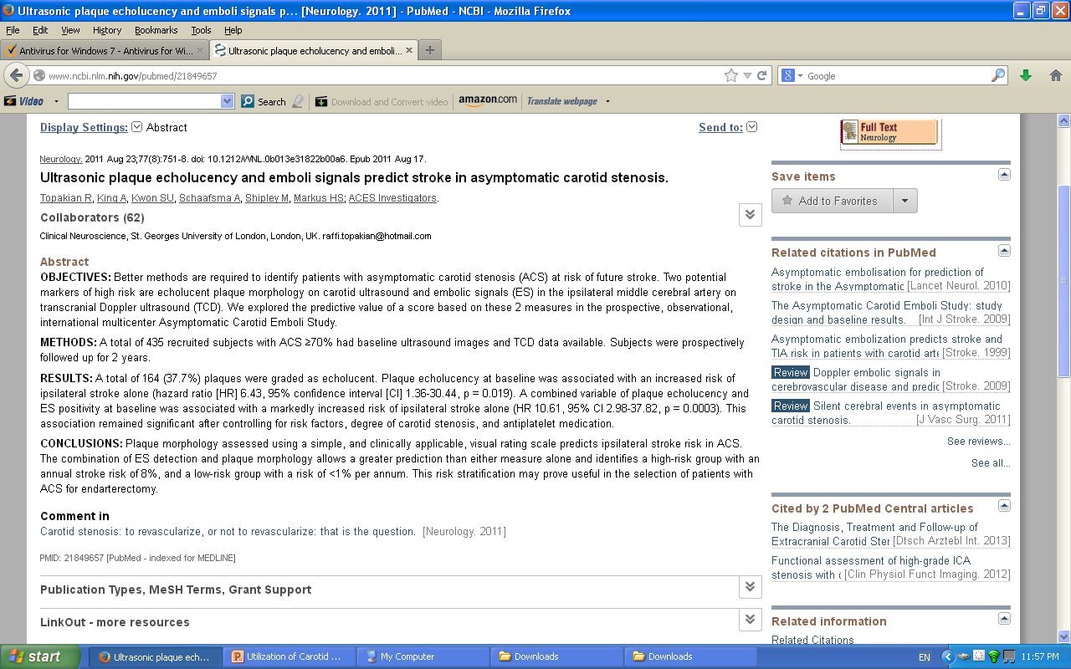
Notes:
Combining morphology of plaque and finding of Embolic signals add more prediction for stroke risk in patients with asymptomatic carotid disease

Slide 32
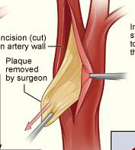
Endarterectomy Vs Stent
Notes:
2 options for treatment of symptomatic carotid disease eiher

Slide 33
Endarterectomy in Symptomatic Carotid Stenosis
    Surgery was the gold standard
    Risk of cerebral infarction with symptomatic 50-99% stenosis within 3 years
Best medical treatment | 23%
Endarterectomy + BMT | 11% (7% operation + 4%)
Notes:
The land mark studies proved that there is a marked benefit from surgical tt against best medical tt at that time

Slide 34
Surgical complications
ECST
Risk of procedure
related stroke and
death
7.0%
NASCET
Risk of procedure
related stroke and
death
5.8%
Notes:
It was founded that from the 2 MEGA trials …………..

Slide 35
Poor Surgical Candidate
High risk-CEA
    Medical unstable with co-morbidity
            CHF or LVEF < 30%
            CABG needed within 6 weeks
            Recent MI
            Unstable angina
            Severe COPD
    Anatomical high risk
      Contra lateral carotid occlusion
      Radiation therapy to neck
      Prior CEA with recurrent stenosis
      High cervical lesions.
Notes:
The complications because there are group of patients identified as High risk CEA

Slide 36
Advantages of endovascular therapy
    Less invasive
    Less traumatic
    Faster and painless
    Avoids dissection of neck
    Avoids nerve damage
    Avoids anesthetic risks
    Patient preference
Notes:
It was a real need for another attractive alternative for CEA

Slide 37
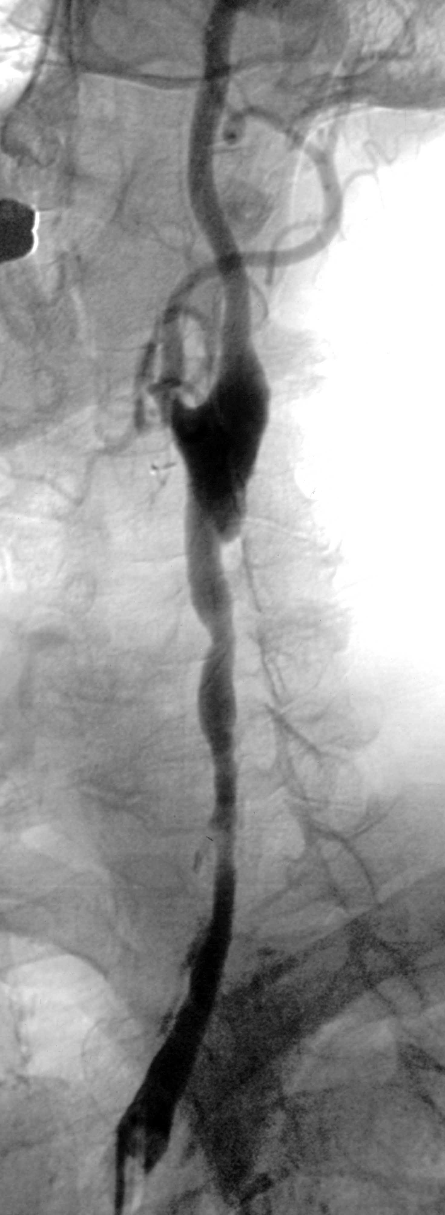
Poor Candidate for Stent
Too Long
Notes:
Once again Stent is not completely feasible either because it is technically difficult or risky

Slide 38
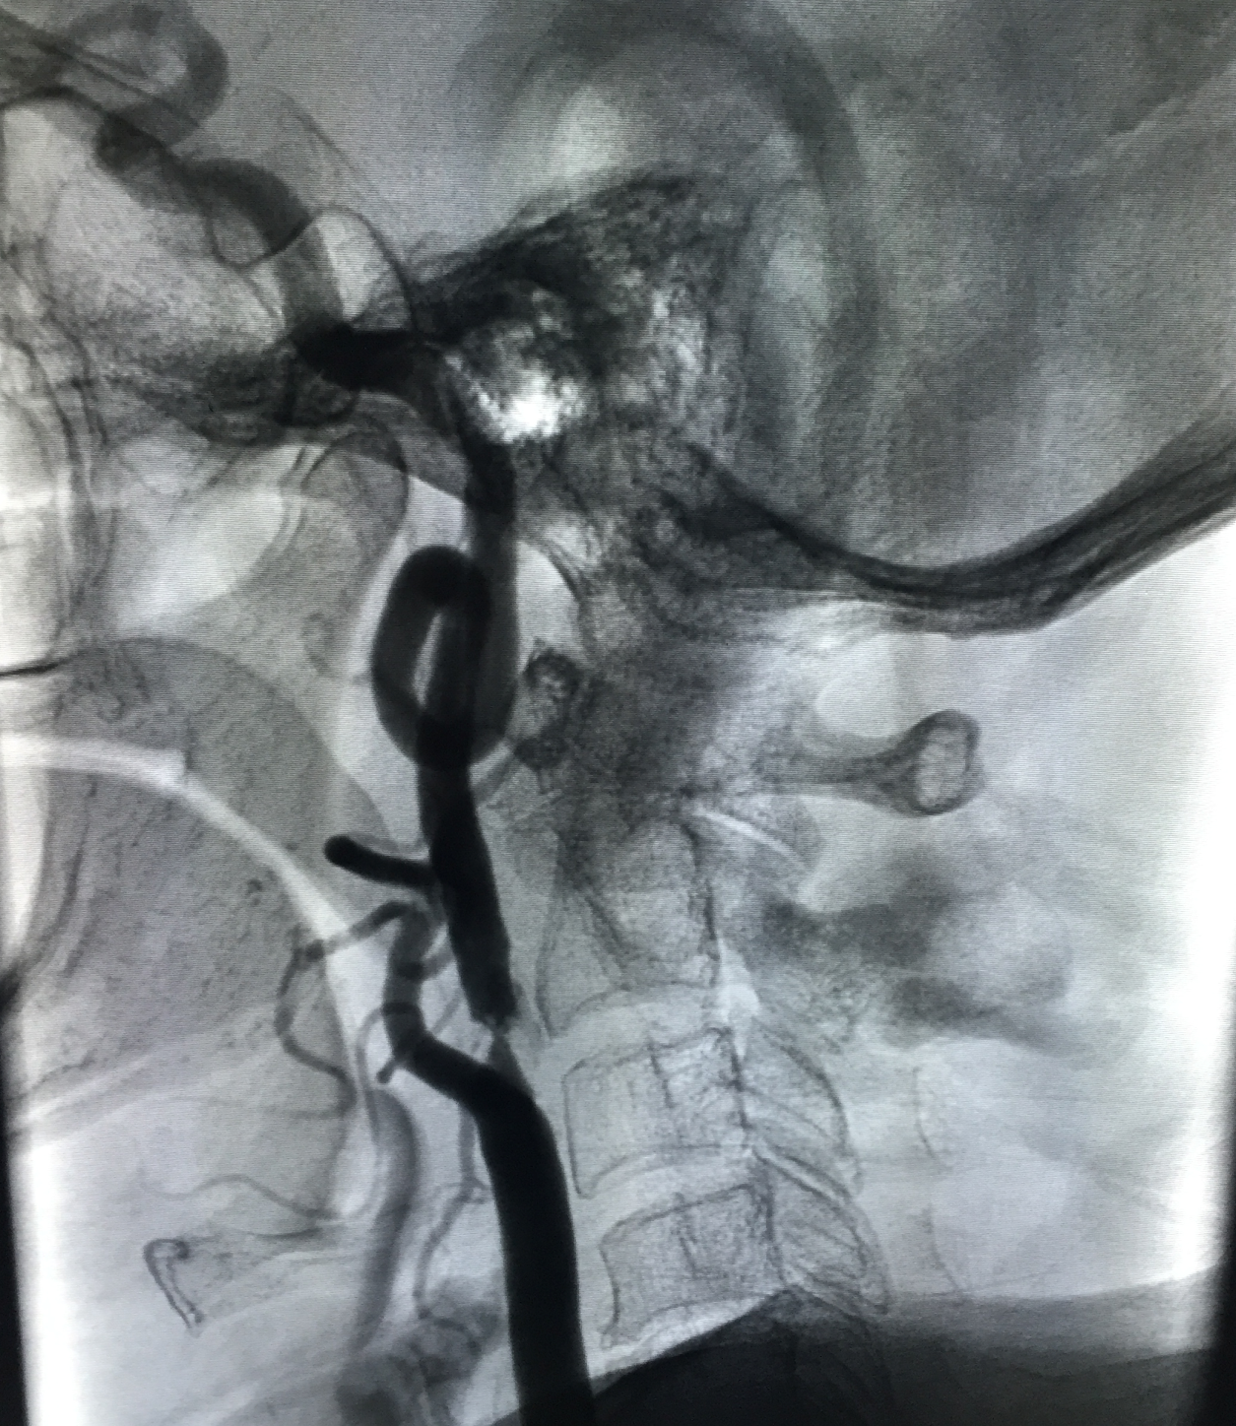
Poor Candidate for Stent
Too Tortuous
Notes:
Once again Stent is not completely feasible either because it is technically difficult or risky

Slide 39
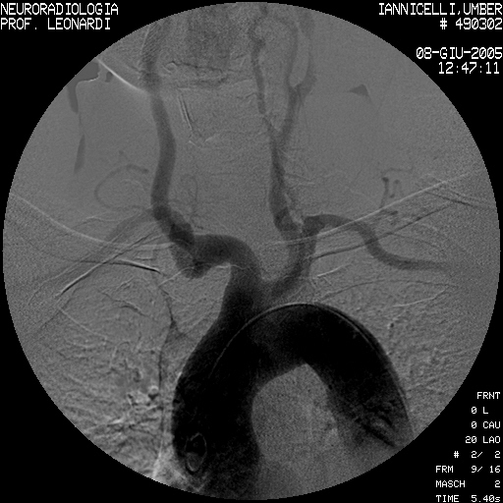
Poor Candidate for Stent
Arch Anomaly
Notes:
Once again Stent is not completely feasible either because it is technically difficult or risky

Slide 40
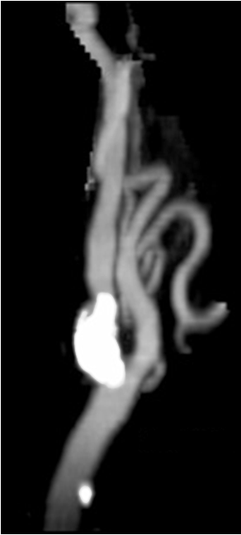
Poor Candidate for Stent
Marked calcification
Notes:
Once again Stent is not completely feasible either because it is technically difficult or risky

Slide 41
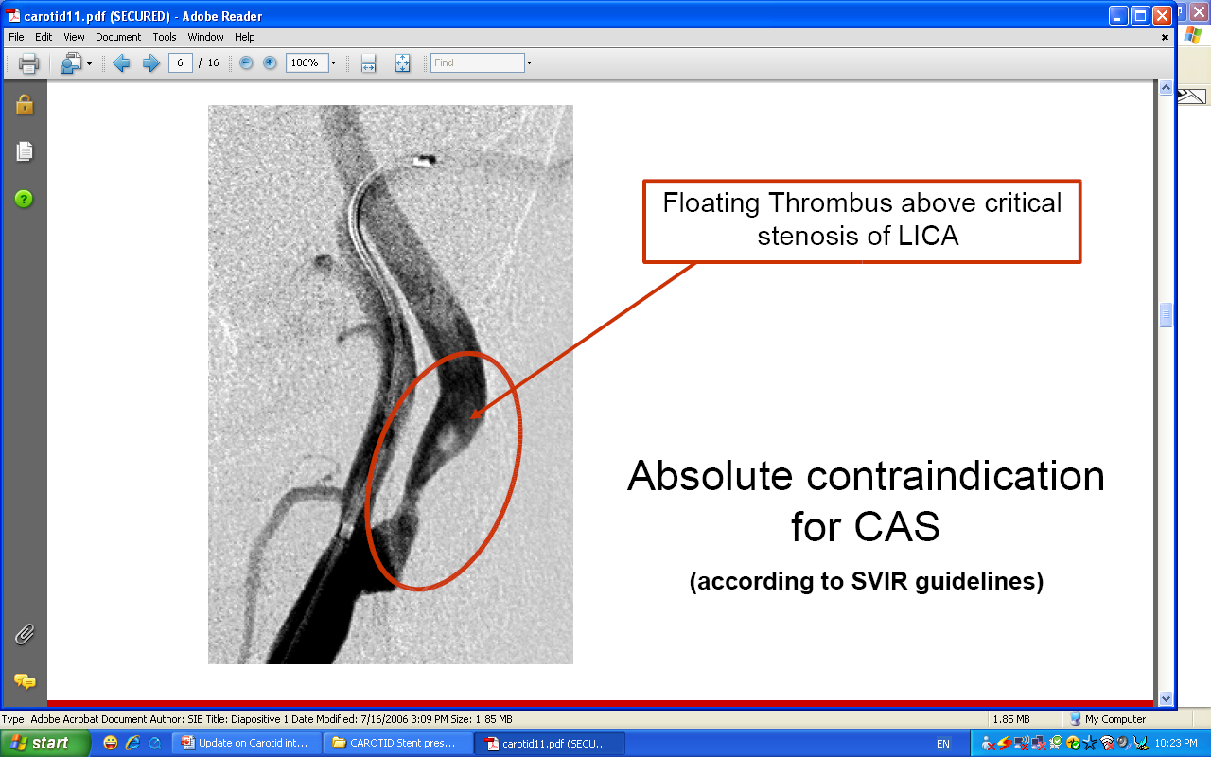
Poor Candidate for Stent
Mobile thrombus
Notes:
Once again Stent is not completely feasible either because it is technically difficult or risky

Slide 42
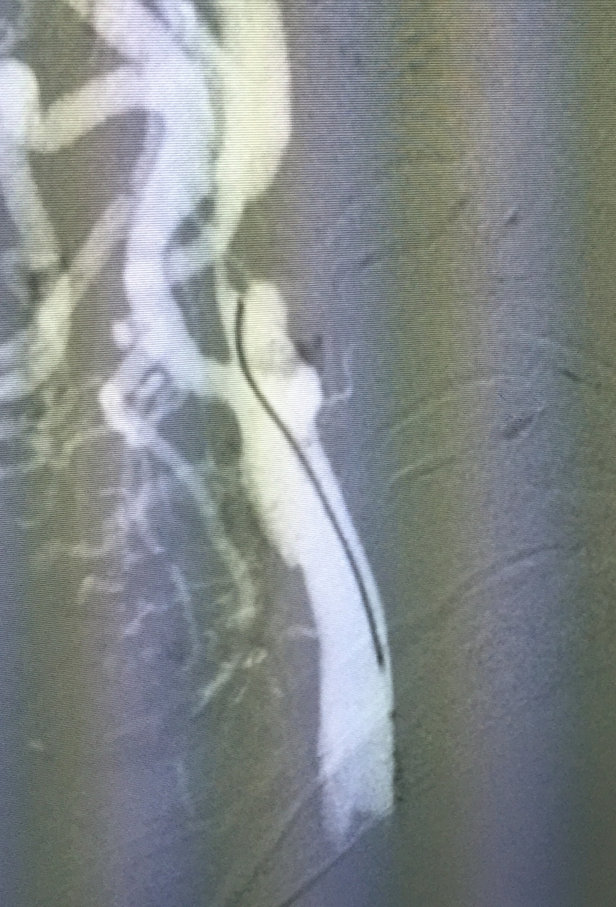
Poor Candidate for Stent
String sign
Notes:
Once again Stent is not completely feasible either because it is technically difficult or risky

Slide 43
Management strategies based on vessel Geometry and Plaque morphology
Notes:
Prior data from non invasive carotid duplex scanning can help in decision making regarding managements strategies

Slide 44
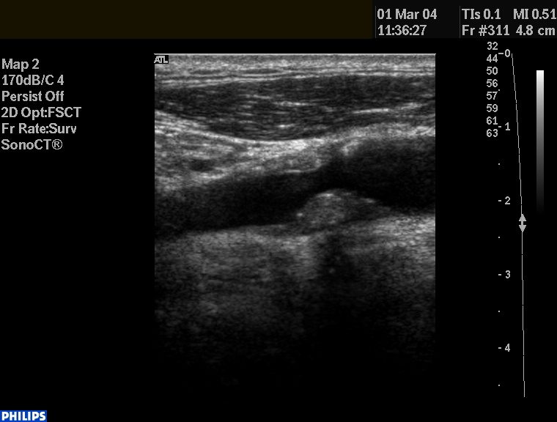
Notes:
Typical vessel geometry and Plaque morphology has a great impact on technical aspect of the procedure . An echogenic stable plaque with fibrous cap usually stented safely

Slide 45
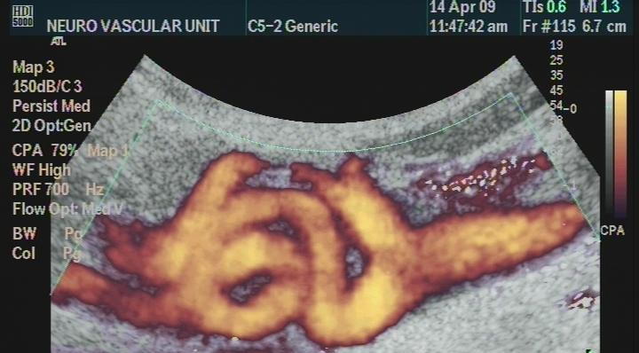
Notes:
Marked looping and toursiousty may make endovascular intervention difficult or risky .

Slide 46
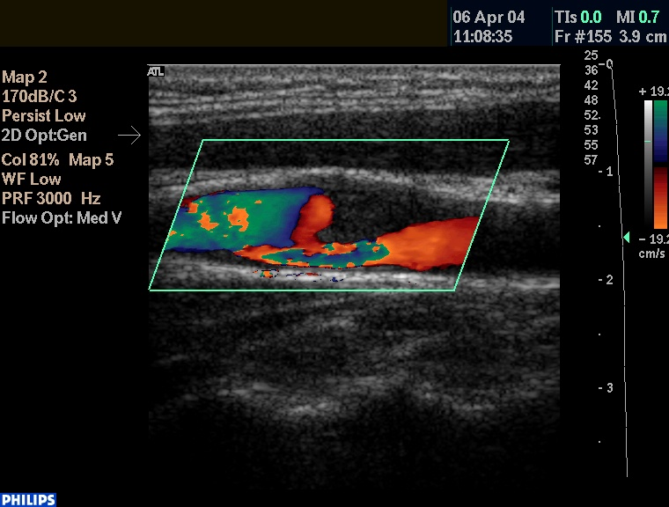
Notes:
Soft Echolucent plaque (Rich in lipid and fatty )…………..High embolic materials

Slide 47
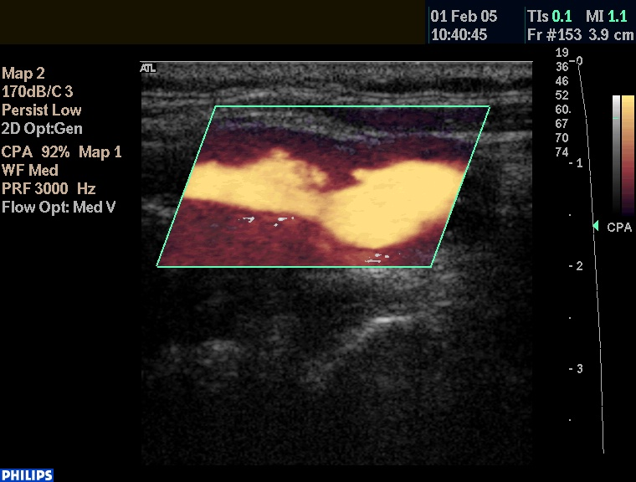
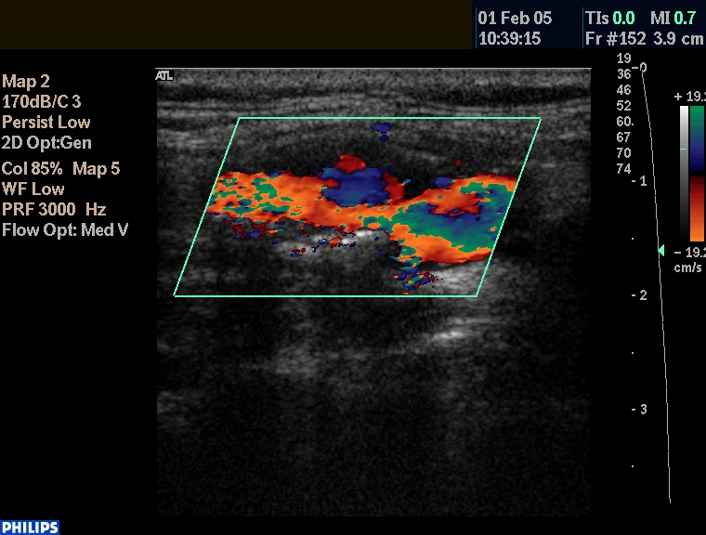
Plaque surface characteristics
Notes:
Plaque ulceration with more potential for ulceration

Slide 48
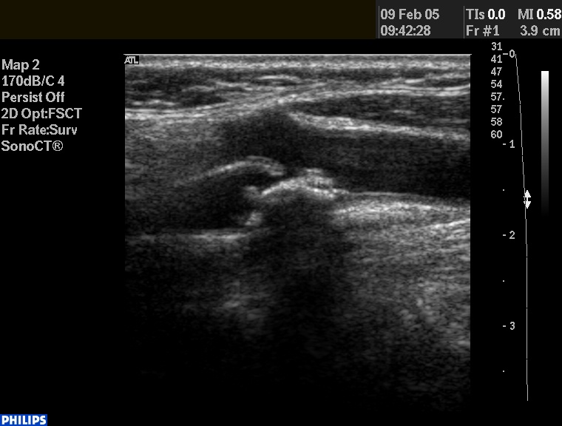
Strongly echogenic plaque with shadowing
Notes:
Highly echogenic plaque interfere with stent deployment and or stent deformation (may be difficult procedure and may need strong pre balloon dilatation ) .

Slide 49
Echo-lucent Plaque & CAS
  Closed-cell design Stents
  Eccentric filters EPD
      seem superior
Hart JB et al – JVS – October 2006
Notes:
Further more it help Even the use of stent type and devices

Slide 50
Before CAS
SURVEILLANCE
Notes:
It is important to follow up success of stent placement as well disease progression of other side

Slide 51
Important Duplex measurements Prior CAS
  TD of Distal CCA
  TD of Distal ICA
  Lesion Length ( exact )
  Angle between CCA and ICA
  Flow velocity criteria

Slide 52
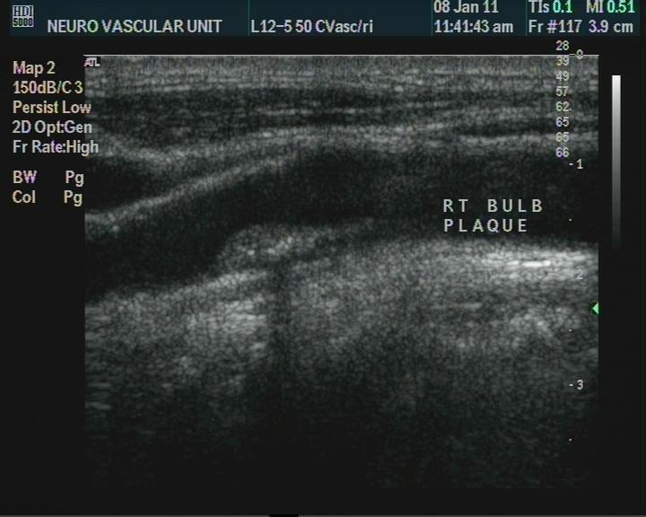

Slide 53
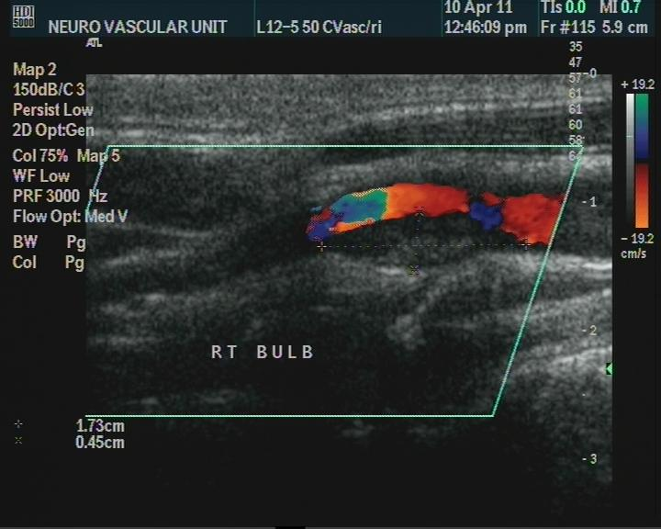

Slide 54
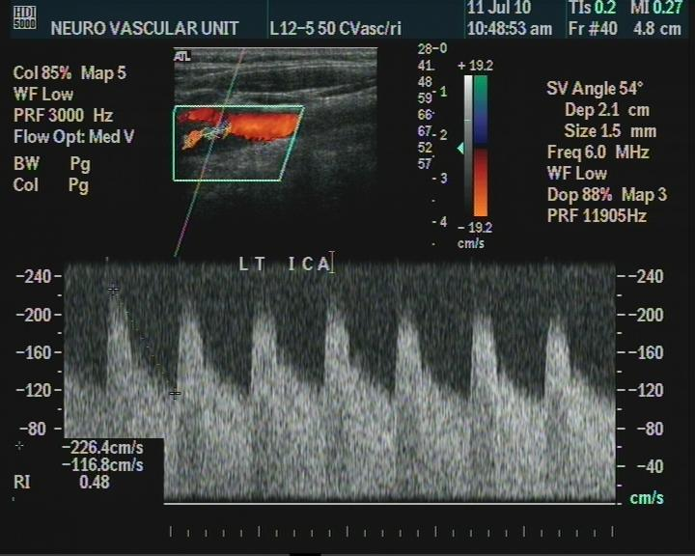
Notes:
We need also flow velocity criteria not only for estimation of degree of stenosis but also for follow up after stent placement to be sure that hemodynamics normalized .

Slide 55
AFTER CAS
SURVEILLANCE
Notes:
It is important to follow up success of stent placement as well disease progression of other side

Slide 56
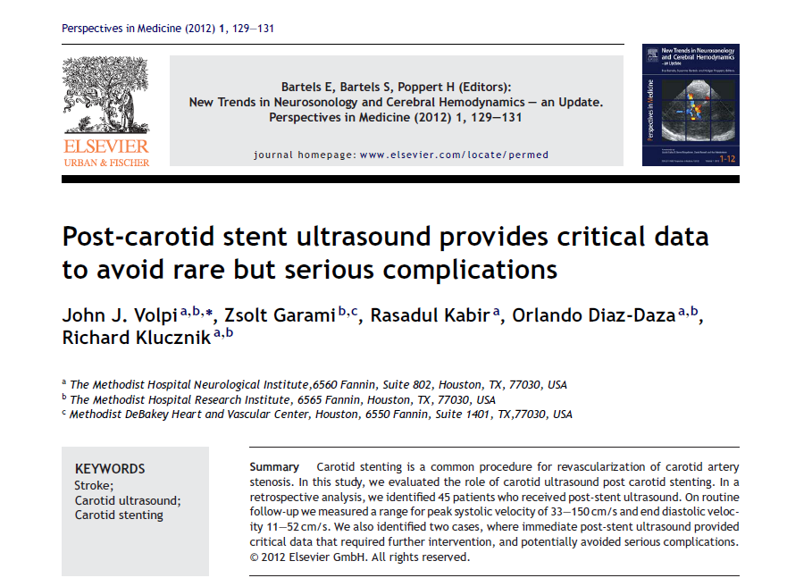

Slide 57
Protocol
  When to follow-up ?
  How to perform adequate ultrasound testing ?
  What to look for ?

Slide 58
When to follow-up
  Before intervention
  After intervention at:
    day 1
    3 months
    6 months
    1 year – 2 years
    annually (path)
Setacci C et al, Stroke, 2008

Slide 59
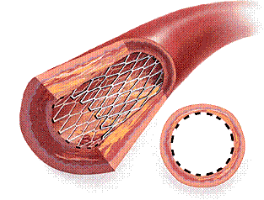
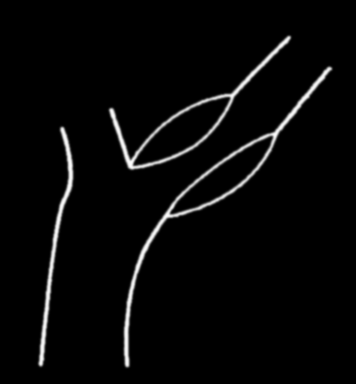
Criteria for patent stent
    No deformities , vessel shows parallel walls
    Vessel lumen: Smooth, widely patent without anatomic defect
    Stent: Echogenic, apposition circumferentially to the arterial wall
    No plaques OR < 40%
    Color fills entire stent lumen
    PSV< 150 cm/sec
    PSV Ratio < 2
ICA
ECA
CCA
Armstrong PA, Vasc Dis, 2007

Slide 60
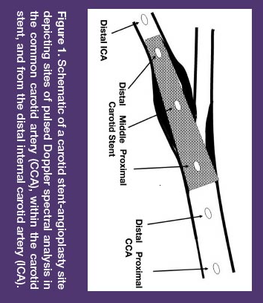
How to measure
Midstream pulsed Doppler- Velocity spectra
Low velocity range Small SV
60-degree angle
Color Doppler / avoid overlapping Power Doppler
Recordings from multiple sites
Maximum PSV from the Stent PSV Ratio along the Stent PSV-Stent to proximal PSV-CCA Ratio EDV
Armstrong PA

Slide 61
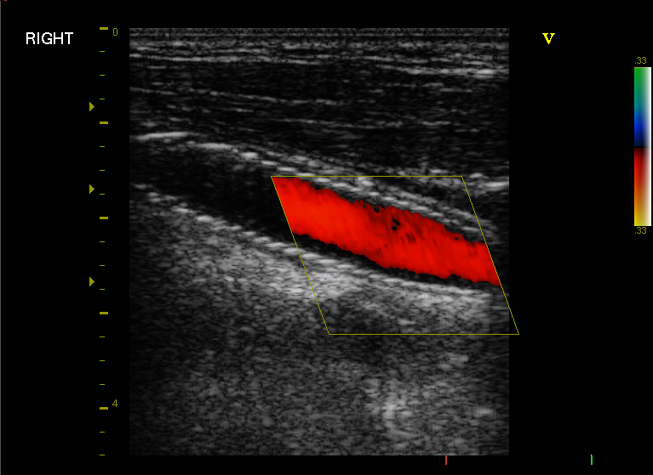
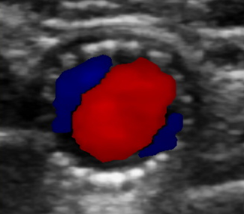
Normal Stent Imaging Color-mode

Slide 62
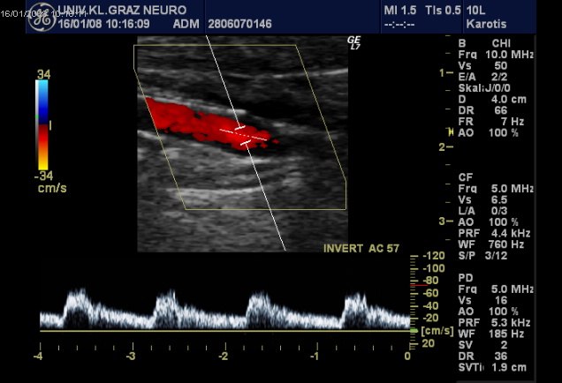
Normal Stent Imaging
Absence of hemodynamic abnormalities:
including turbulences and changes of flow velocities
PSV < 150 cm/sec, PSVStent Ratio along the stent lenght
< 2, ECA flow patent

Slide 63
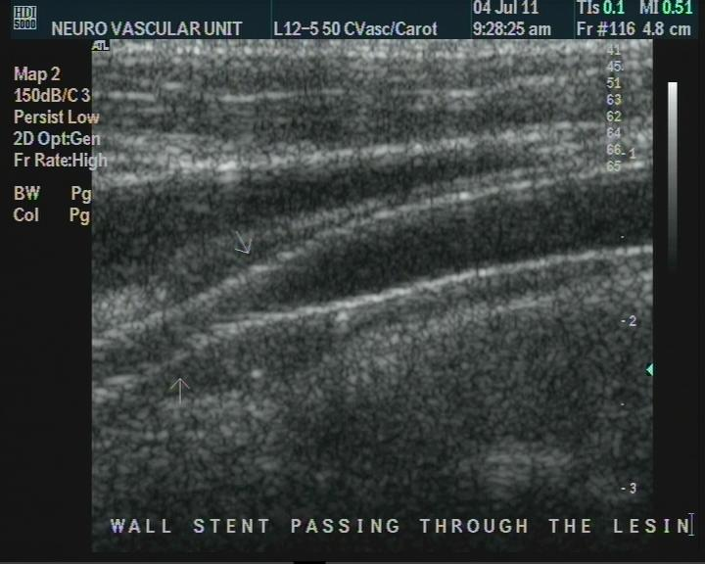

Slide 64
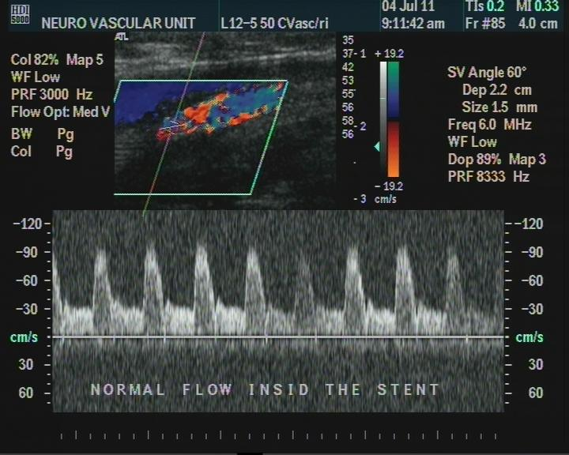

Slide 65
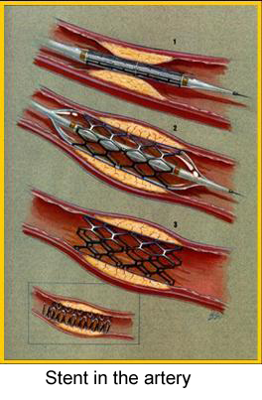
Stent Imaging: Pathological Findings
Residual Stenosis
Stent Thrombosis
Restenosis and Occlusion
Vasospasm
Dissection Overdilation (aneurysm)
Stent Deformation
Stent Embolization

Slide 66
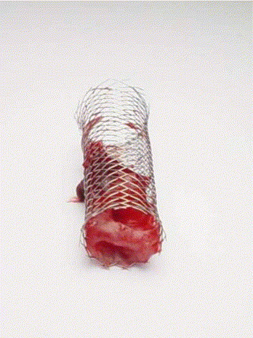
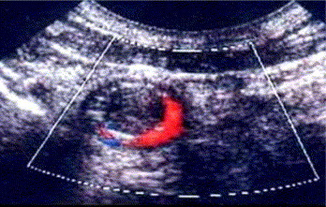
Stent Thrombosis
Courtesy of Carlo Setacci and colleagues Journal of Vascular Surgery 2005

Slide 67
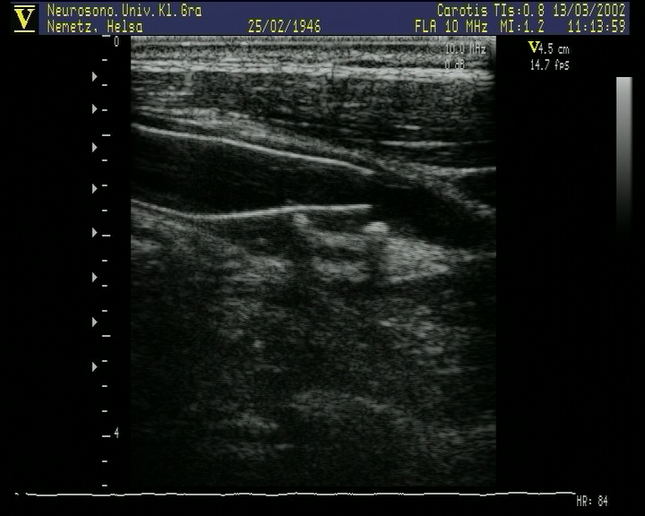
Stent Deformation

Slide 68
Stent Restenosis

Slide 69
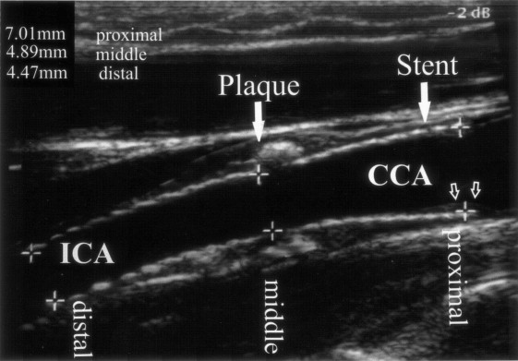
Unstable phase (1 month – 1 year)
start of ingrowth of the neointima between 1 and 3 months layer becomes more and more echogenic thickening occurs to 1 mm at 12 months overwhelming leads to intimal hyperplasia and restenosis
Willfort-Ehringer A, J Enddovasc Ther, 2003
Notes:
Stent restenosis usually appears at the end of first year

Slide 70
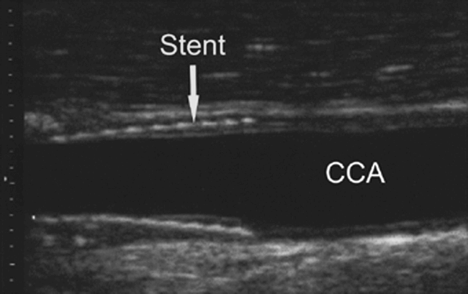
Final stable phase (> 1 year)
Complete incorporation of the stent stable neointima layer more or less stable
Willfort-Ehringer A, J Enddovasc Ther, 2003
Notes:
After first year less likely because of stable phase

Slide 71
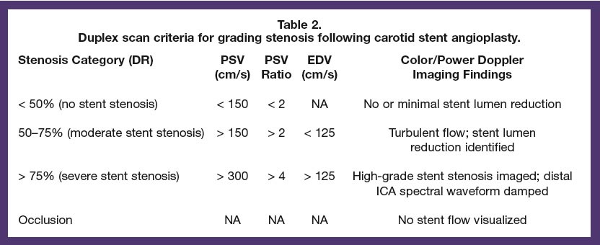
Duplex scan criteria for grading stenosis following Stent-PTA
Armstrong PA, Vasc Dis, 2007

Slide 72
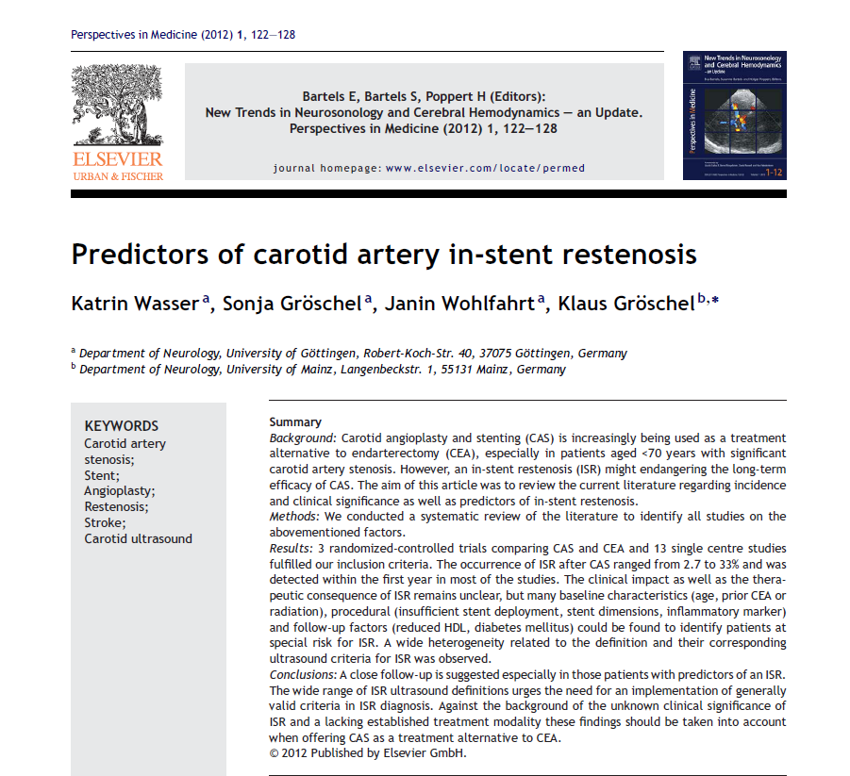
Notes:
The Q is , are there some predictors for stent restenosis ?

Slide 73
Predictors of in-stent restenosis
Old age
Hypertension
Stenting in radiation induced carotid stenosis
Stenting in previous CEA
Insufficient stent adaptation
longer, narrower sten

Slide 74
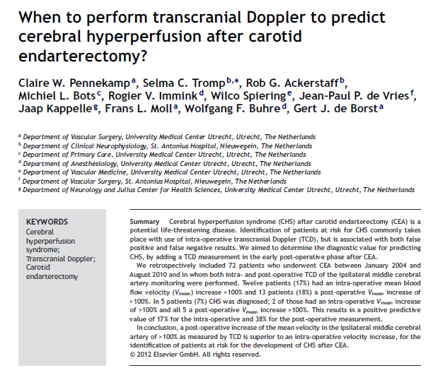
Hyper perfusion syndrome

Slide 75
Key message
Carotid ultrasound is a reliable Primary screening tool for screening carotid artery disease
It can predict risk for future stroke with other parameters .
The vessel geometry and lesion morphology can help in decision making and technical aspect of the procedure .
Long term follow up for stent patency .

Slide 76
References
Abd Allah F, Baligh E, Ibrahim M. Clinical relevance of carotid atherosclerosis among Egyptians: a 5-year retrospective analysis of 4,733 subjects. Neuroepidemiology. 2010 Sep 29;35(4):275-9.
Moustafa RR, Moneim AA, Salem HH, Shalash AS, Azmy HA. Intracranial steno-occlusive arterial disease and its associations in Egyptian ischemic stroke patients. Stroke. 2013 Feb 1;44(2):538-41.
Abd-Allah F, Kassem HH, Hashad A, Shamloul RM, Zaki A. Prevalence of intracranial atherosclerosis among patients with coronary artery disease: a 1-year hospital-based study. European neurology. 2014;71(5-6):326-30.
Setacci C, Chisci E, Setacci F, Iacoponi F, de Donato G. Grading carotid intrastent restenosis. Stroke. 2008 Apr 1;39(4):1189-96.
Armstrong PA, Bandyk DF, Johnson BL, Shames ML, Zwiebel BR, Back MR. Duplex scan surveillance after carotid angioplasty and stenting: a rational definition of stent stenosis. Journal of vascular surgery. 2007 Sep 30;46(3):460-6.
Wasser K, Gröschel S, Wohlfahrt J, Gröschel K. Predictors of carotid artery in-stent restenosis. Perspectives in Medicine. 2012 Sep 30;1(1):122-8.

Slide 77


Slide 78


