Slide 1
Texture Analysis and
Other Quantitative Assessment of Skeletal Muscle Images
World Congress of Neurology, Kyoto (09/2017)
TEACHING COURSE 11: NEUROSONOLOGY WORKSHOP
Hiroyuki Nodera, MD
Department of Neurology
Tokushima University (Japan)
(hnodera@tokushima-u.ac.jp)

Slide 2

Disclosure
X | No, nothing to disclose
 | Yes, please specify:

Slide 3
Learning objectives
  To learn quantitative methods
  in muscular US
  To learn about Texture analysis
  To learn about Radiomics
and Machine learning

Slide 4
Quantification of muscle US
Texture analysis
Radiomics and
Machine learning

Slide 5
Quantification of muscle US
Texture analysis
Radiomics and
Machine learning

Slide 6
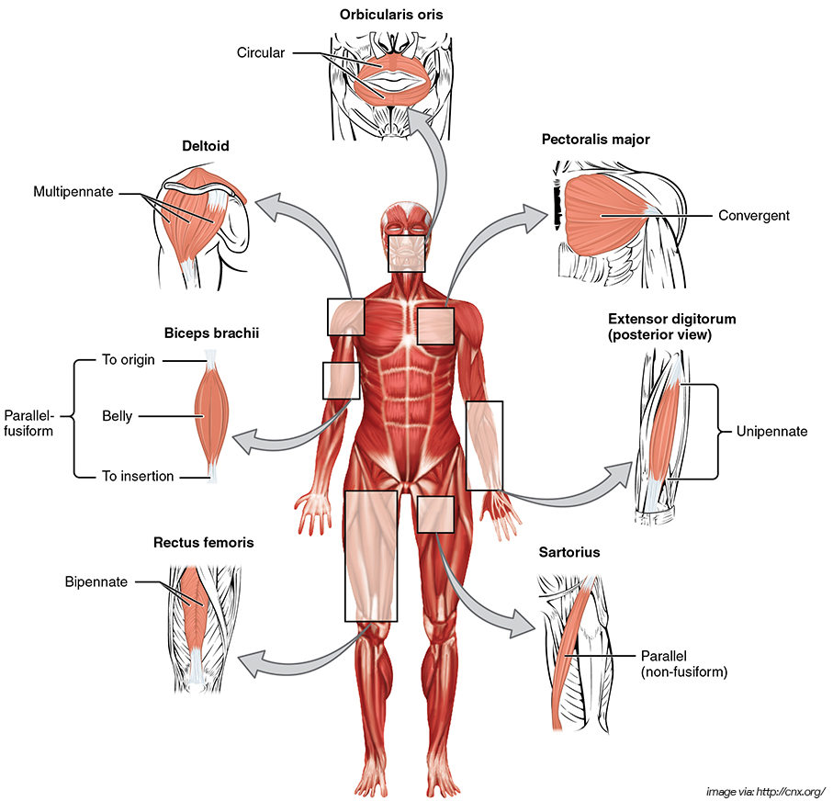
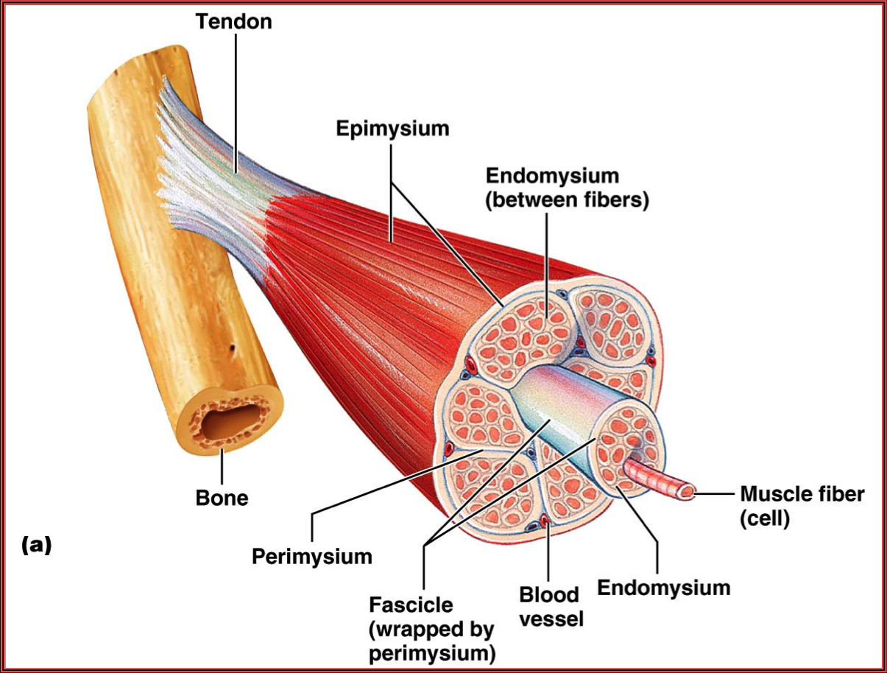
Muscle structure
https://www.studyblue.com/
https://www.nurseslabs.com

Slide 7
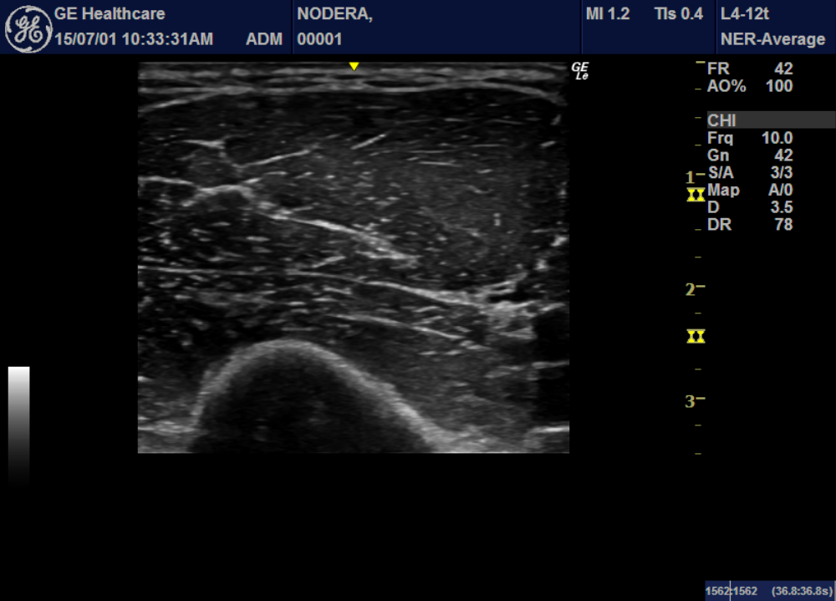
Muscle US (biceps brachii): short axis

Slide 8
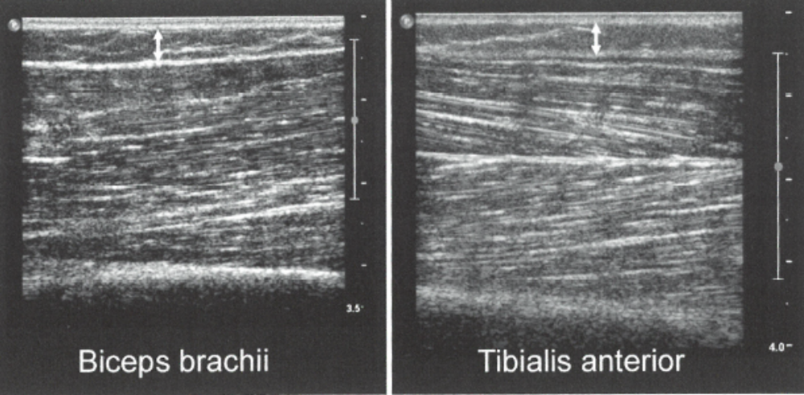
Muscle: different shapes
Parallel Bipennate
Central
aponeurosis
Neuromuscular Imaging: Wattjes & Fischer (Eds), Springer

Slide 9
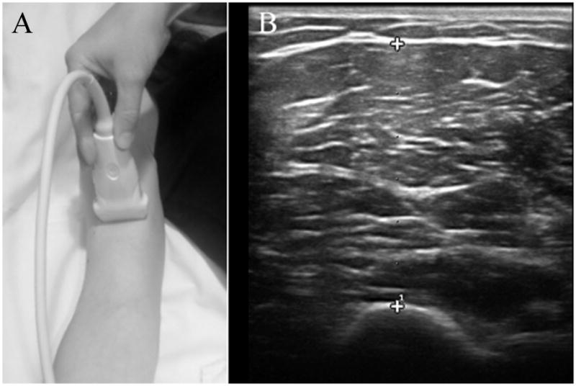
Measure muscle thickness
Cartwright M, et al. (2011)

Slide 10
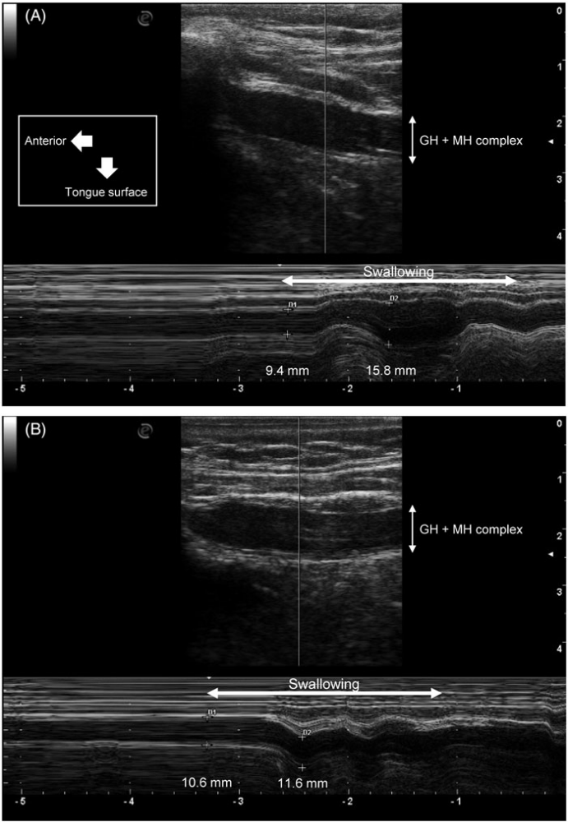
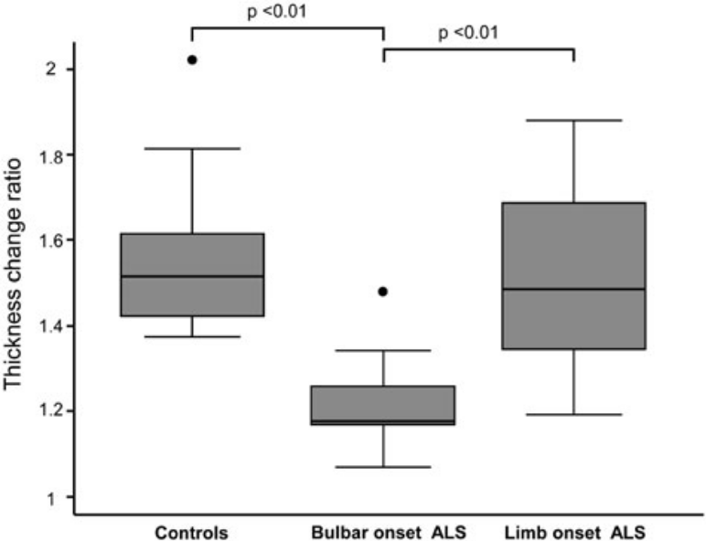
Tongue thickness & dynamic changes
Control
ALS
Noto Y, et al. (2017)

Slide 11
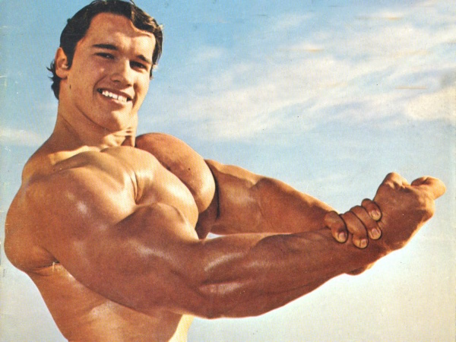
Normal value??

Slide 12
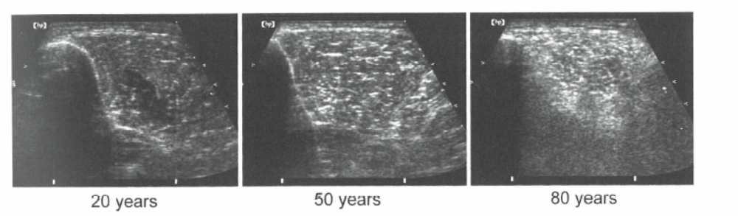
Aged Muscle (sarcopenia)
Echo intensity
Neuromuscular Imaging: Wattjes & Fischer (Eds), Springer

Slide 13
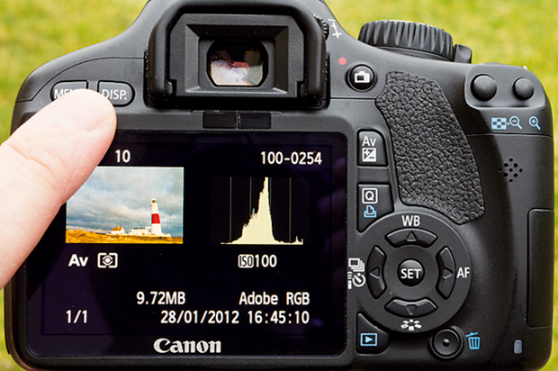
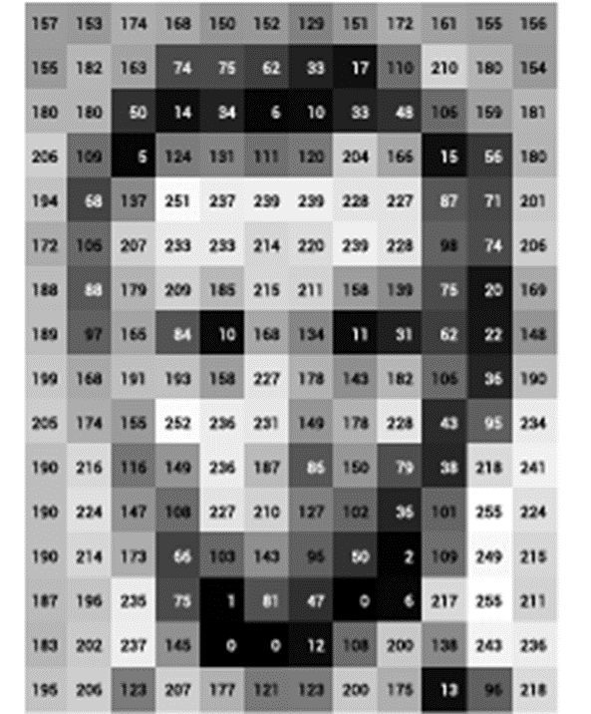
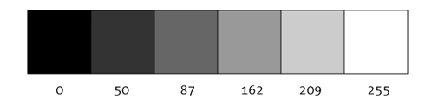
Histogram to measure echo-intensity

Slide 14
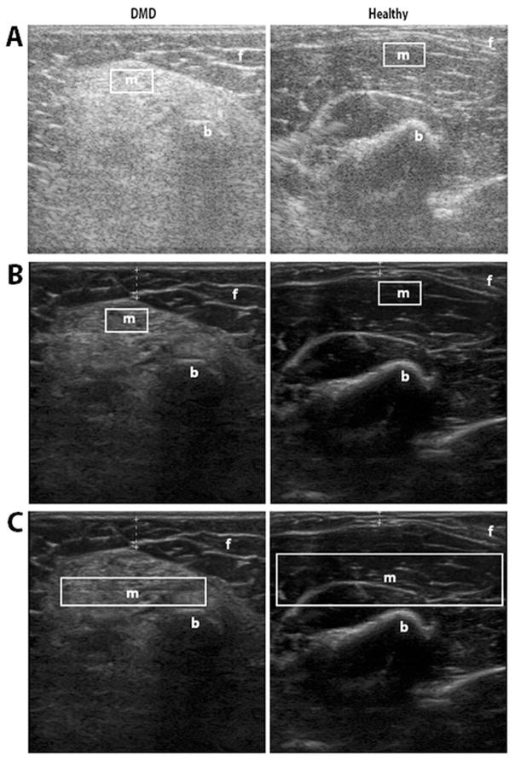
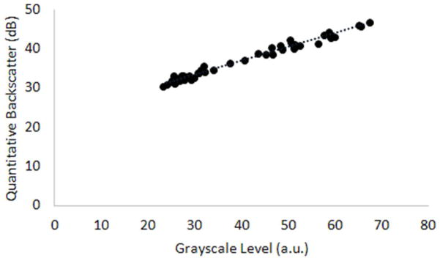
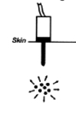
Backscatter and Gray scales are both useful
Shklyar I, et al. (2015)

Slide 15
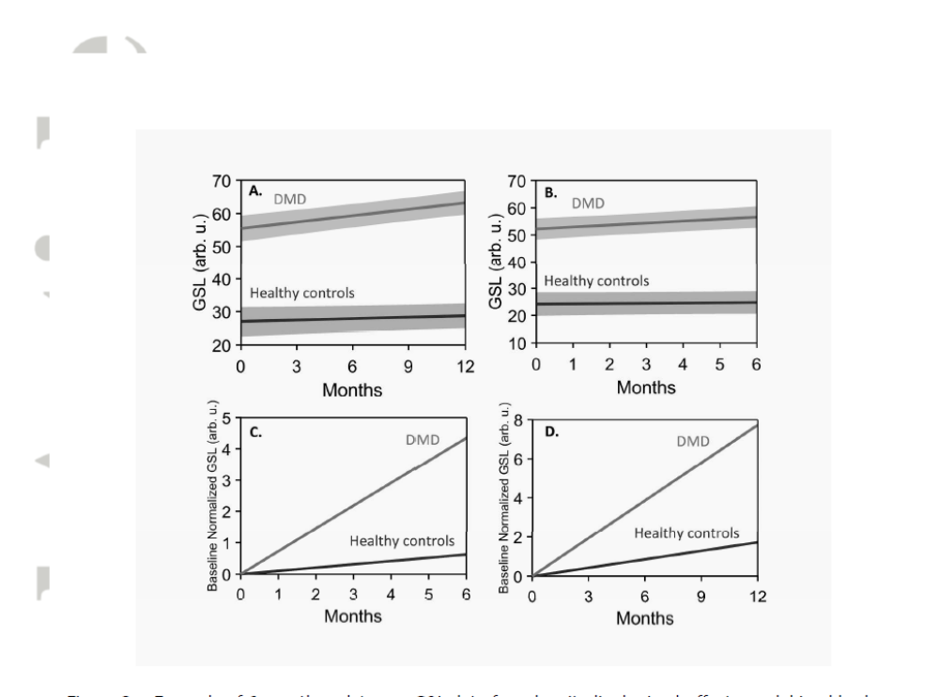
Grayscale as imaging biomarker
Zaidman, et al. (2017)

Slide 16
Quantification of muscle US
Texture analysis
Radiomics and
Machine learning

Slide 17
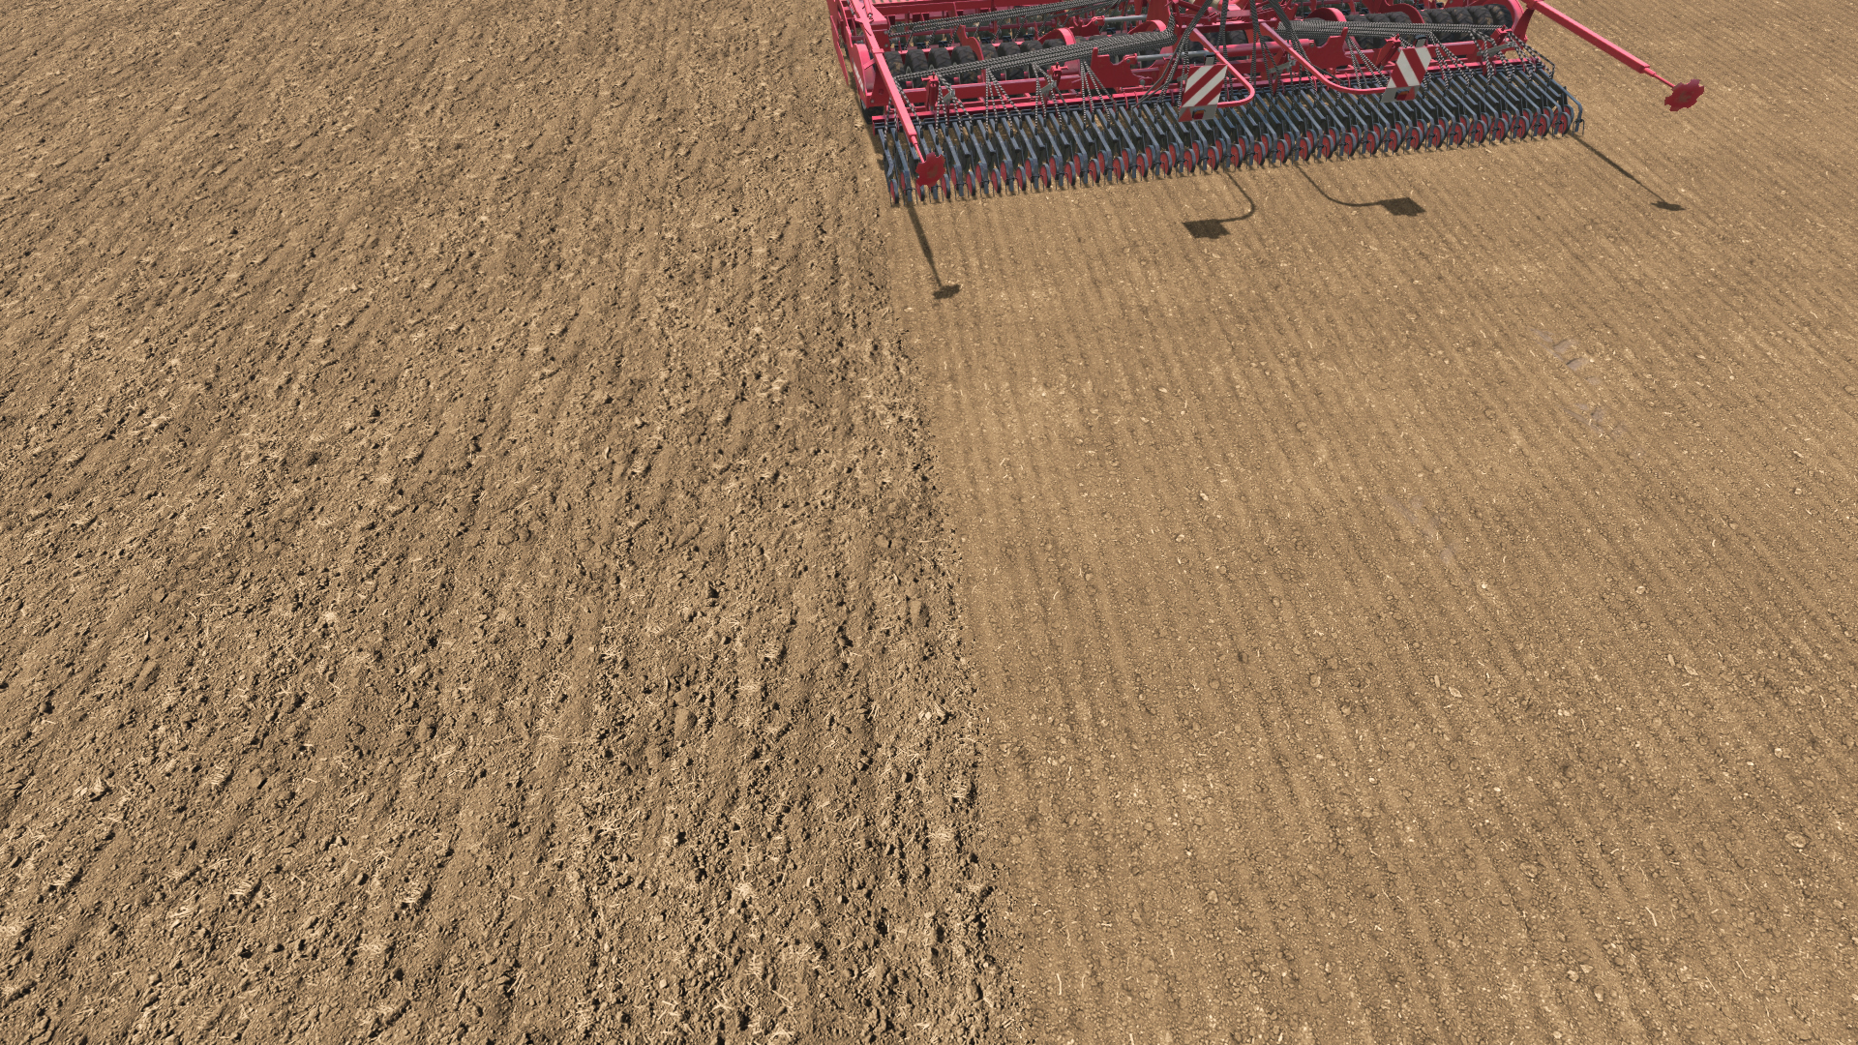
Texture: coarseness & regularity of image

Slide 18

Texture analysis：fine structure of image
Histogram: density of
individual pixels
Texture: relative relationships
between adjacent pixels
Reflects fine structure

Slide 19
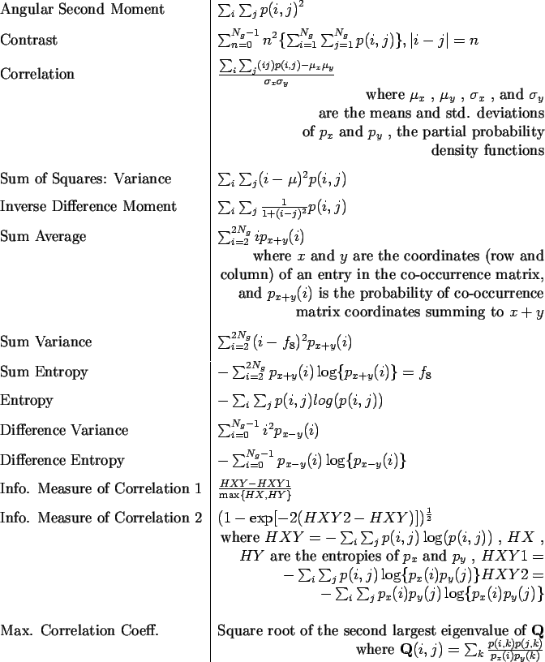
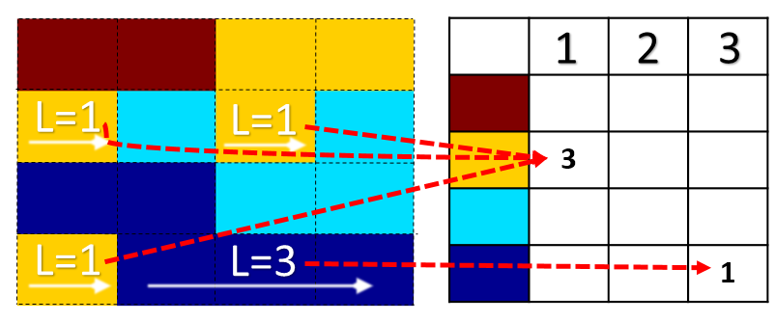
Texture features
Run-length matrix

Slide 20

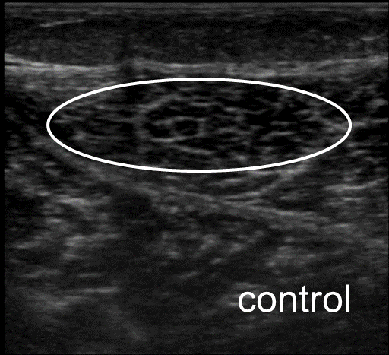
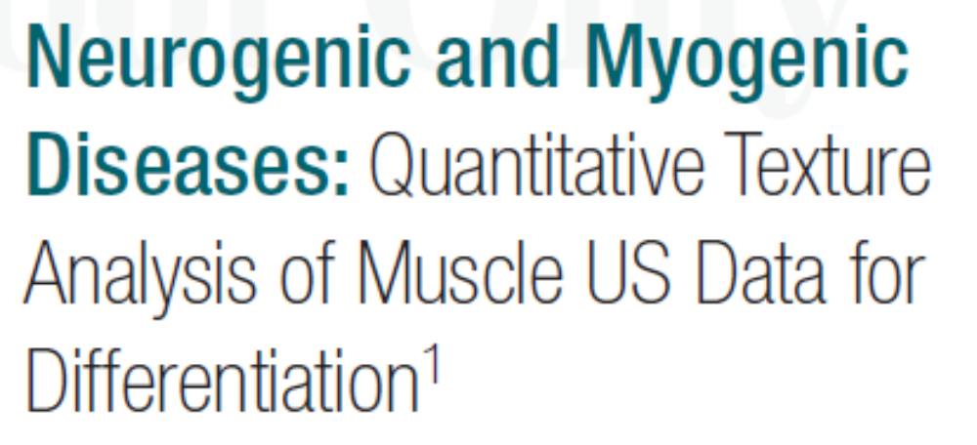
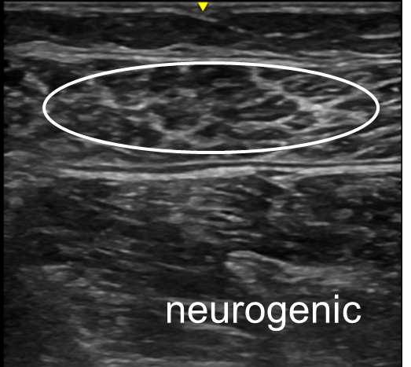
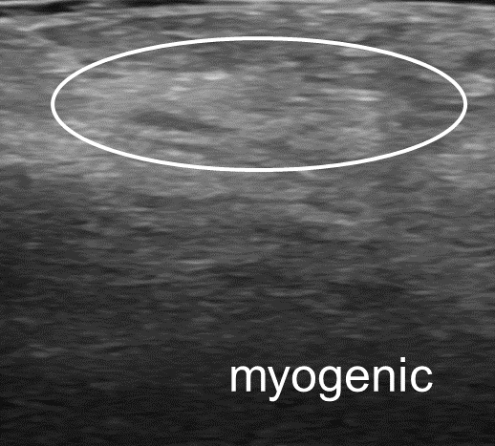
(Sogawa, Nodera, et al. 2017)

Slide 21
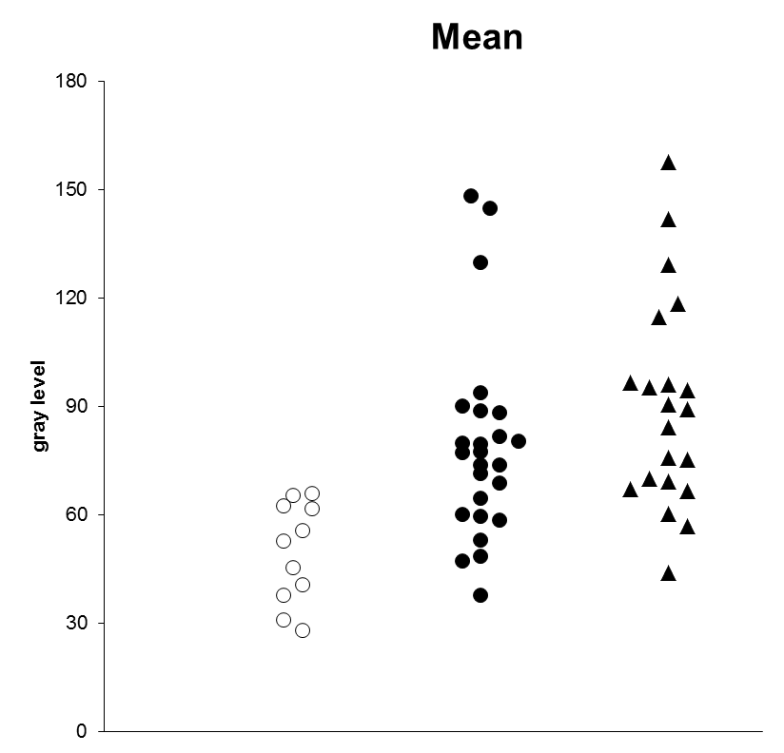
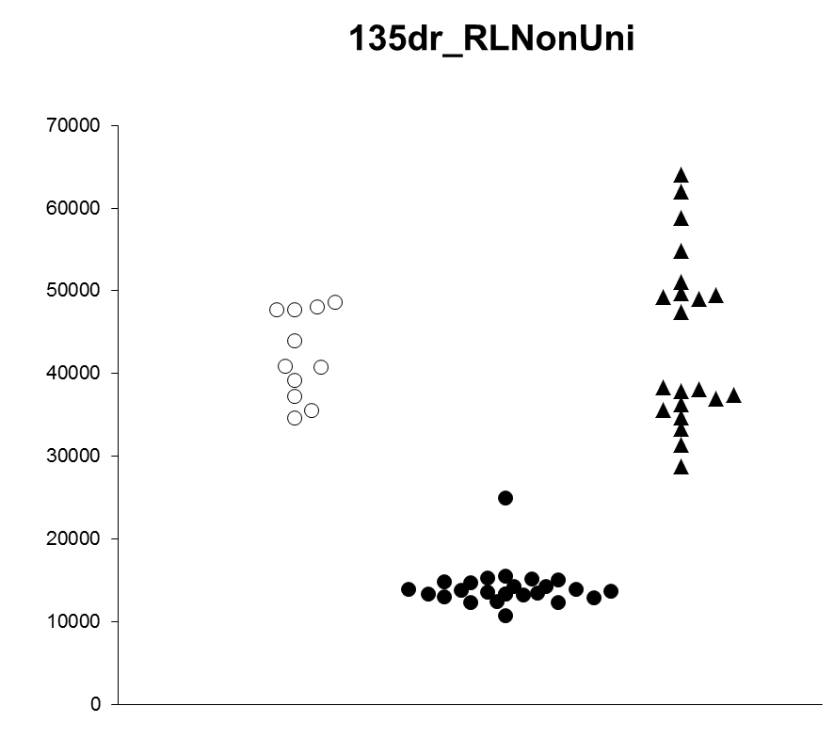
Fine image structure to imply histology
Mean echodensity
Run-length matrix
P < 0.001
P < 0.001
○: control
●: neurogenic
▲: myogenic
Correctly identified in 95.7％
Sogawa, Nodera, et al. Radiology 2017

Slide 22
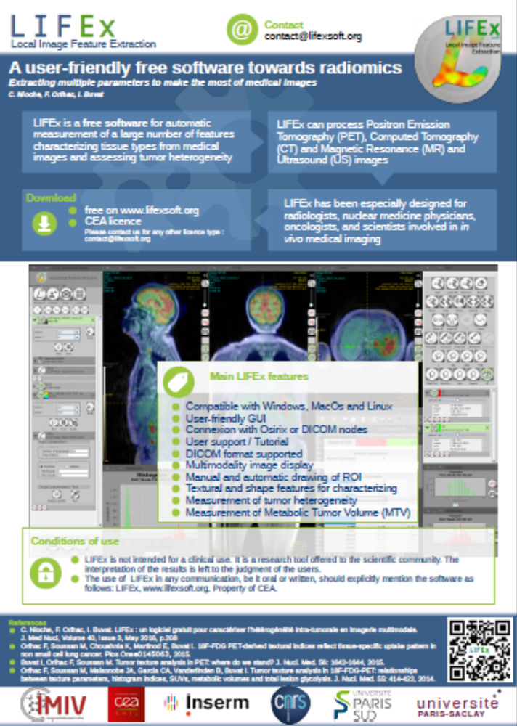
Texture analysis software
www.lifexsoft.org

Slide 23
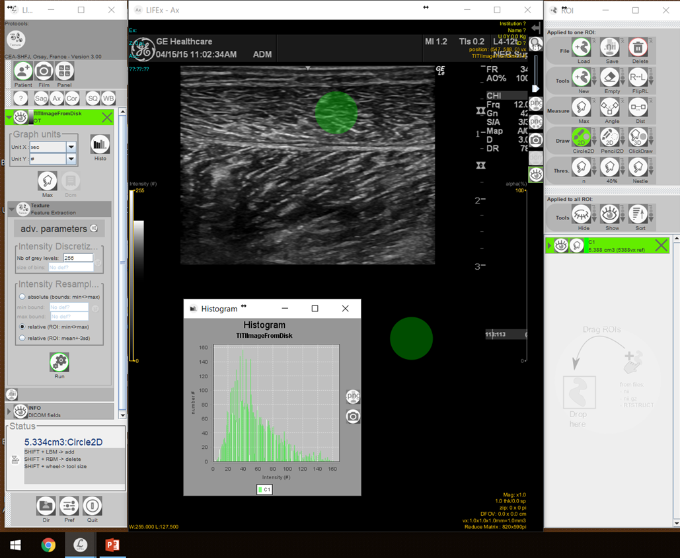
Texture analysis: LIFEx

Slide 24
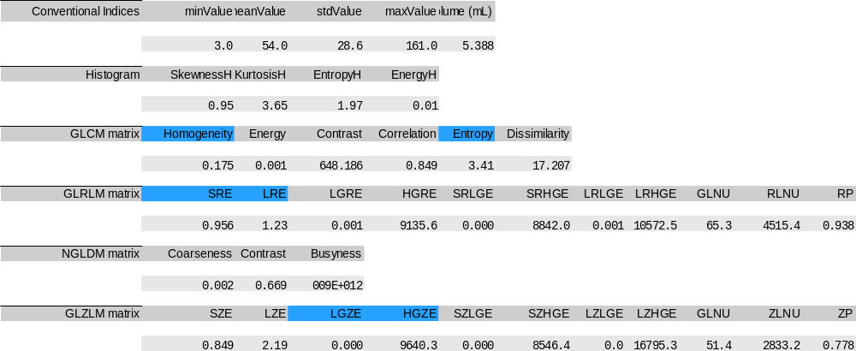
Sample results (LIFEx)

Slide 25
Quantification of muscle US
Texture analysis
Radiomics and
Machine learning

Slide 26
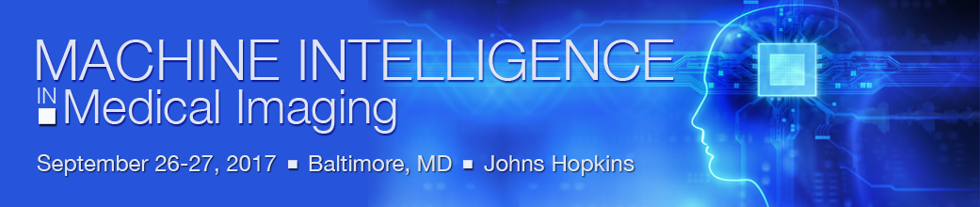
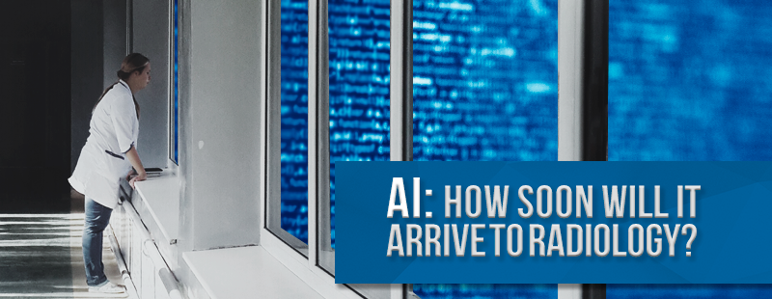

Slide 27
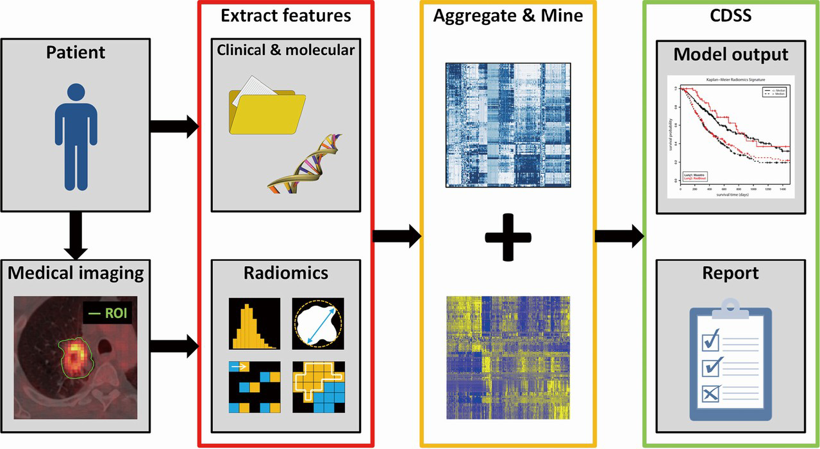
Radiomics in cancer medicine
Scrivener M, et al. (2016)

Slide 28
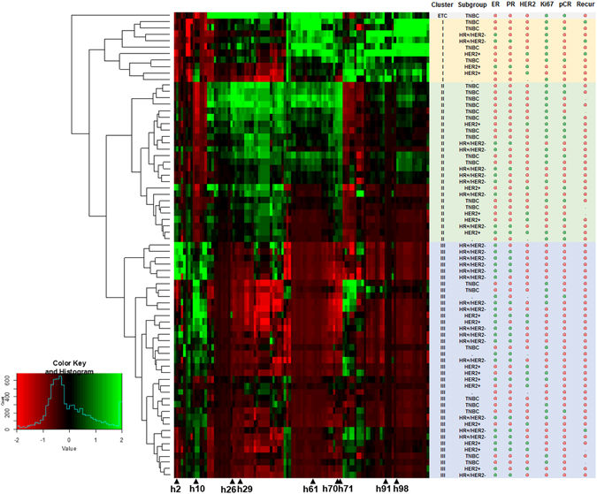
Pattern identification
Texture features (PET/CT)
Breast
Cancer
subtypes
Ha S, et al. (2017)

Slide 29
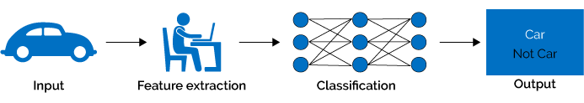
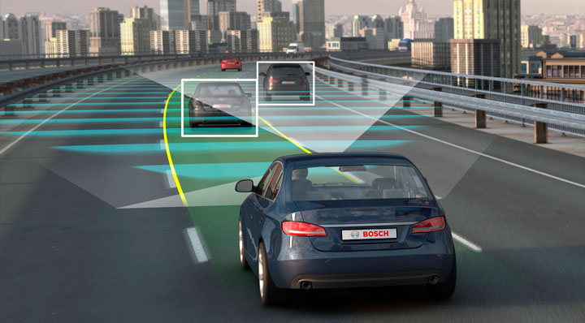
Machine learning/ Deep learning
(www.hackernoon.com)
(www.zipcar.com)

Slide 30
Key messages: quantitative analysis
in muscular ultrasound
Novel techniques
as imaging biomarker
(2) Automatic identification / diagnosis

