Slide 1




TCCD ULTRASOUND IN GUIDING VASOSPASM TREATMENT AFTER SAH
TCCD ULTRASOUND IN GUIDING VASOSPASM TREATMENT
AFTER aSAH
Prof. Dr. med. Fabienne PERREN
HUG, University Hospital of Geneva
Stroke Center, Neurosonology Unit
Geneva, Switzerland

Slide 2
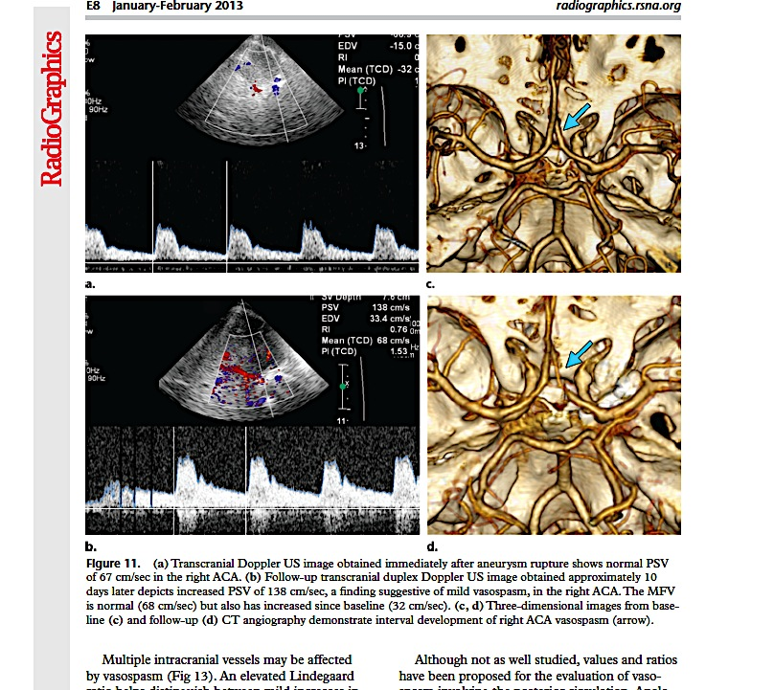

INTRODUCTION
Cerebral vasospasm (CV) after aSAH is a narrowing of the large and medium-sized intracranial Aa. (partic. ant. circulation supplied by the ICAs: M1, A1; BA)
CV leading to delayed cerebral ischemia (DCI/DIND): major complication and source of morbidity in aSAH.
However, the maximum rate of DCI among patients with large artery VS is only 50 %
Up to 1/3 of patients with DCI do not show evidence of large artery VS
Stroke 1985;16(4):562–72; Stroke 2000;31(7):1621–7; Stroke. 2004;35(8):1862–6.

Slide 3
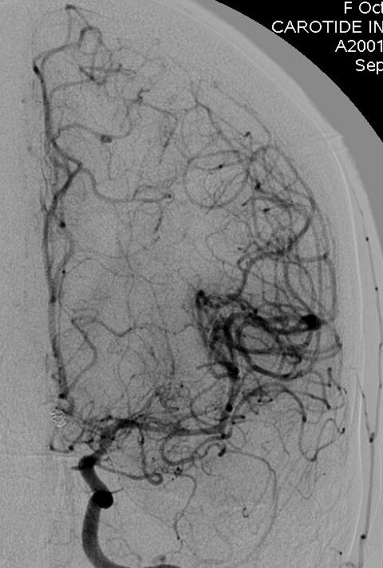
Delayed narrowing or VS occurs in up to 70% after aSAH
tend to occur between day 2-17 after SAH
detectable on DSA in 21-70% of patients who suffer from aSAH.
Maximal severity between days 7-12. Rarely, may last for 3 to 4 weeks or even longer.
DSA: « gold standard » assessing cerebral VS. It is, however, an invasive procedure and cannot be repeated at frequent intervals to monitor the development and resolution of arterial narrowing following SAH.
Neurosurg Clin N Am 1990;1:335-47; J Neurosurg 1978;48:173-8
Notes:
3

Slide 4

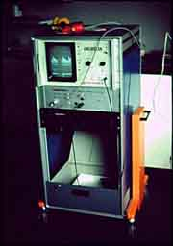
Aaslid et al. described the method of TCD sonography and immediately demonstrated its ability to non-invasively detect flow-velocity acceleration attributable to VS
J Neurosurg 1982;57:769-77; J Neurosurg 1984;60:32-36
Notes:
4

Slide 5
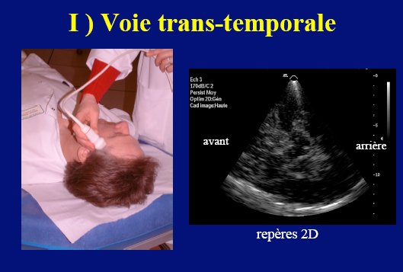
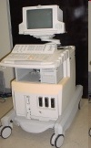
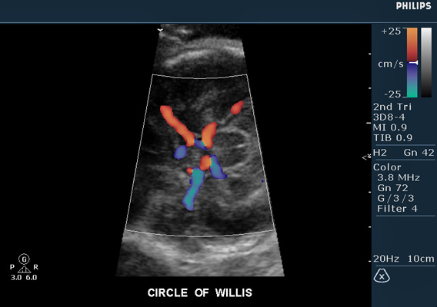
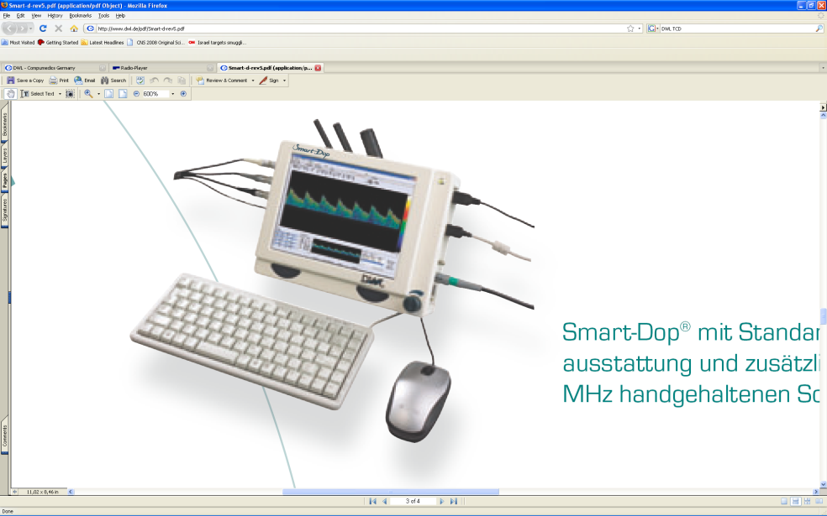
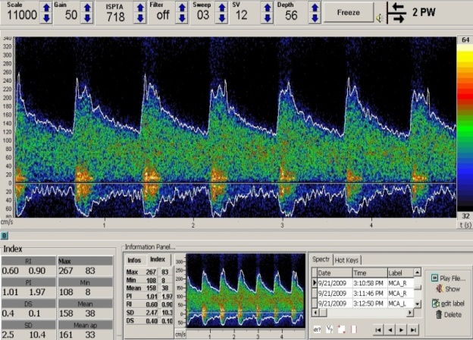
Transcranial ultrasound
TCCD
TCD
1-2MHz sector transducer
TCD: “blind” , Doppler signal only
TCCD: visualization of vessels, flow direction and Doppler
signal in real time (duplex/ triplex), CA studies (30-40%)
Notes:
5

Slide 6
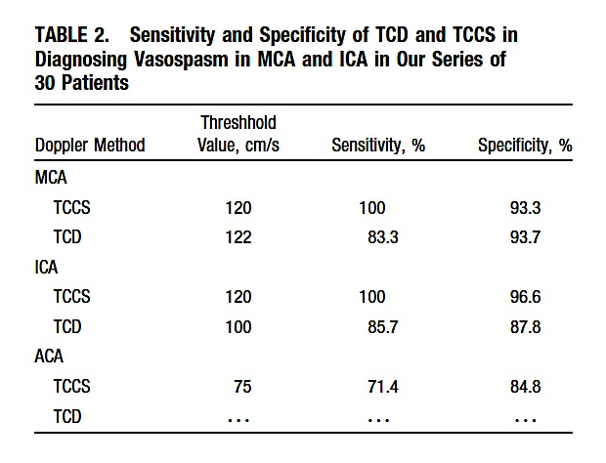
Stroke 1999;30:1091-8

Slide 7
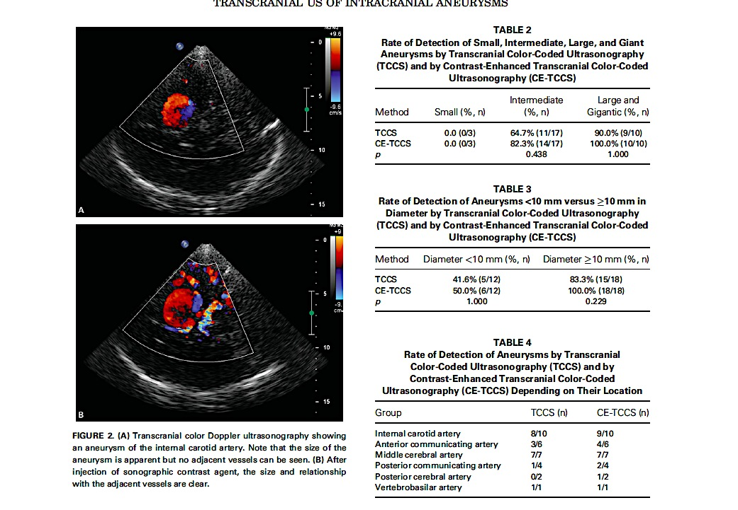
< 5mm
J Clin Ultrasound 2012;40:535-9

Slide 8
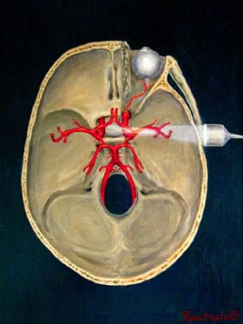
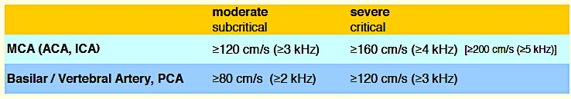
Sonographic CBFV increase:
ATS Intracranial stenosis: PSV >160 cm/s
MCBFV mainly used based on TCD (no angle correction)
Computed automatically by the machine or manually (trace)
Cut-off values for VS in SAH:

Slide 9
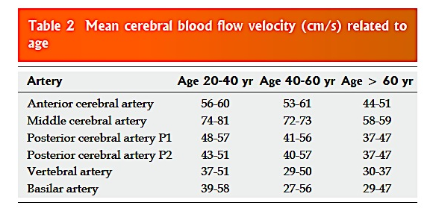
Factors influencing CBFV :
Age: with increasing age -> CBFV decrease (approx. 25%)
ICP: if increasing (critical VS, edema) -> CBFV decrease (CV underestimation)
(CAVE: RI >0.6 or PI>1 and low CBFV)
World J Cardiol 2016; 8(7): 383-400

Slide 10
Factors influencing CBFV :
Hematocrit: if decreasing -> CBFV increase (5%->10%)
(CAVE: correction needed)
Hyperperfusion: false CBFV increase
(CAVE: correction according published ratios)
Pregnancy: decrease in the 3rd trimester
PCO_{2:} if increasing -> CBFV increase
Stroke 1988;19;1466-9; Neurologie Compact, Thieme 2013

Slide 11
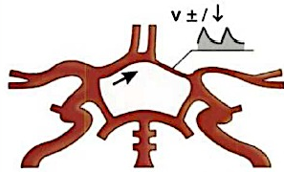
Factors influencing CBFV :
Long stenosis: the longer, the lower max. intrastenotic CBFV
(Pre- / post-stenotic flow)
Localisation of the VS: angle of insonation may affect CBFV (ICA, PCA, ACA;
Presence of collateral flow:
Distal VS: lower CBFV in distal branches; detection of VS can be missed
(CAVE: look for distal stenoses)
Doppler- und Duplexsonographie der hirnversorgenden Arterien, Springer 2004

Slide 12
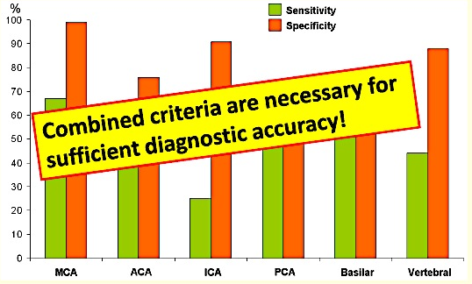
Stroke 2001;32:2292-8

Slide 13
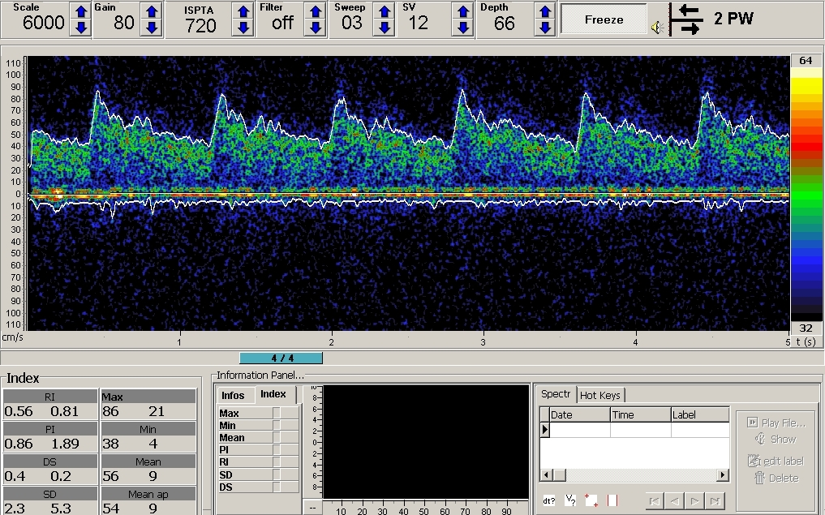

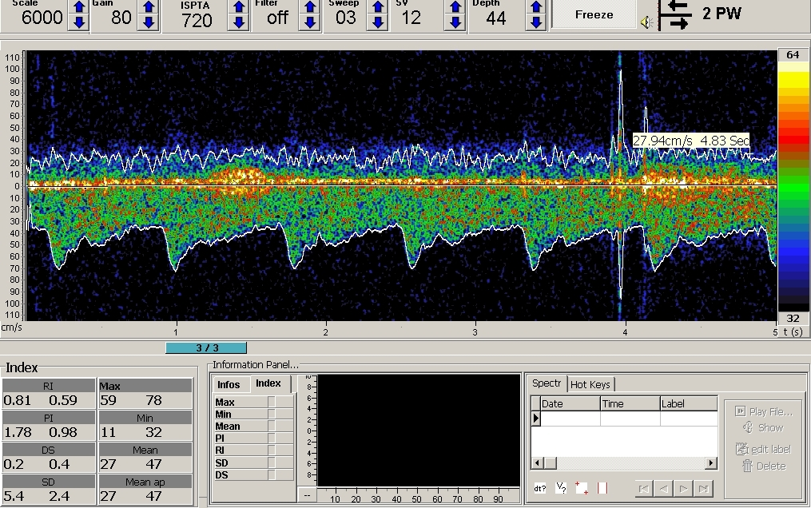
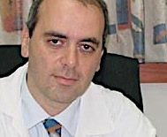
Ultrasound criteria of vasospasm: the indexes
V mean MCA (cm/s)
LI =
V mean ICA (cm/s)
LI<2: hyperperfusion
LI ≥ 3 at least moderate: sensitivity 85%, specificity 98%
LI >6: severe vasospasm
V mean BA (cm/s)
SI =
V mean VA3* (cm/s)
*Mean of both VA3 segments at 40-50mm depth
SI>2 at least mild/moderate: sensitivity 100%, specificity 95%
SI>3 severe vasospasm
Acta Neurochir; 1989;100:12-24; Stroke 2002;33:72-7
Notes:
13

Slide 14
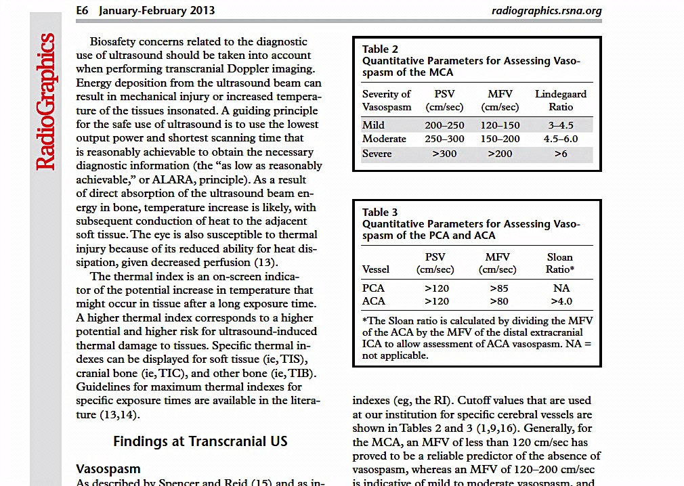
Ultrasound criteria of vasospasm: the indexes
V mean ACA (cm/s)
Sloane Index/Ratio =
VS if >4
V mean ICA (cm/s)
Radiographics 2013;33:E1-E14

Slide 15
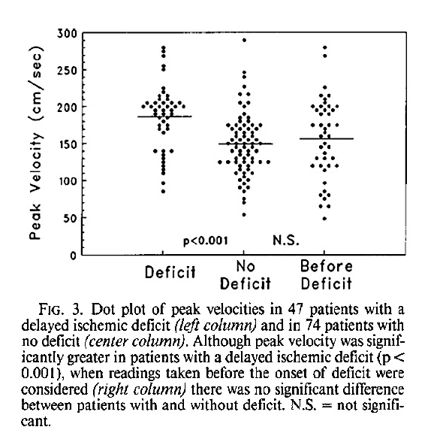
Identifying high risk VS: by CBFV?
Maximum mCBFV values often occur after onset of symptoms
mCBFV alone is not suitable
Comprehensive hemodynamic view is mandatory
JNS 1993;78:183-7

Slide 16
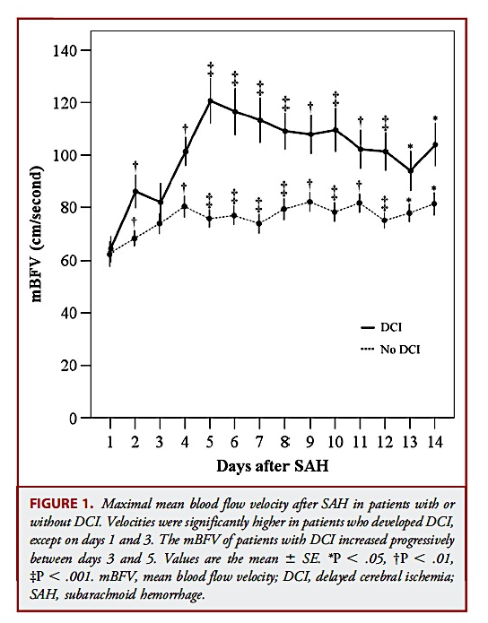
Identifying high risk VS: by Time course?
Critical VS: prone to clinical symptoms
mCBFV increase >50cm/s per day
mCBFV increase ≥50% per day within
the 1st week after SAH onset
mCBFV increase ≥100% per day within
the first10 days after SAH onset
Neurosurgery2011;69:876-83; JNS 1993;78:183-7; Neurocrit Care 2005; Kohama et al. Cerebrovasc Dis 2016;6:32-9

Slide 17
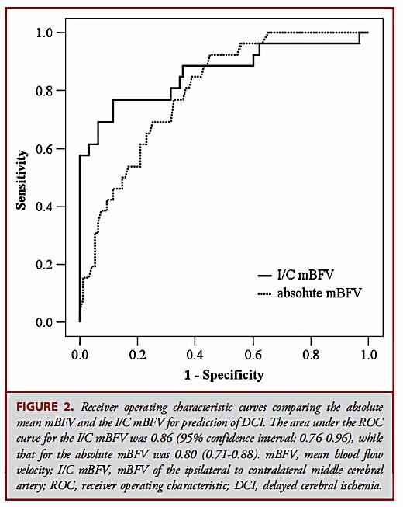
Identifying high risk VS: by Asymmetry?
Asymmetry mCBFV in MCA:
ratio ipsi- vs contralateral side
Asymmetry ratio >1.5: sensitivity 77%;
specificity 80% for DIND
Higher accuracy than mCBFV (0.86 vs 0.80)
Combine mCBFV and asymmetry?
Asymmetry
mCBFV
Optimal thresholds:
Asymmetry ratio >1.5
mCBFV >125 cm/s
Neurosurgery2011;69:876-83

Slide 18
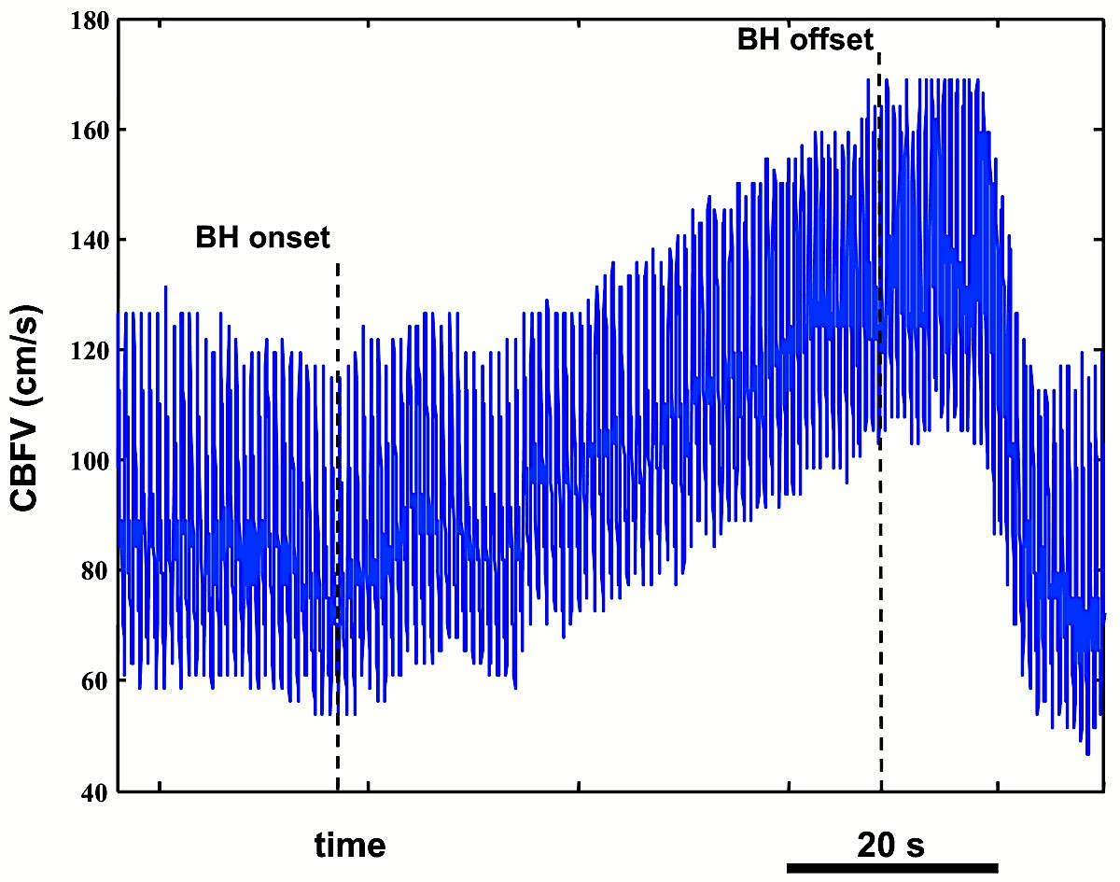
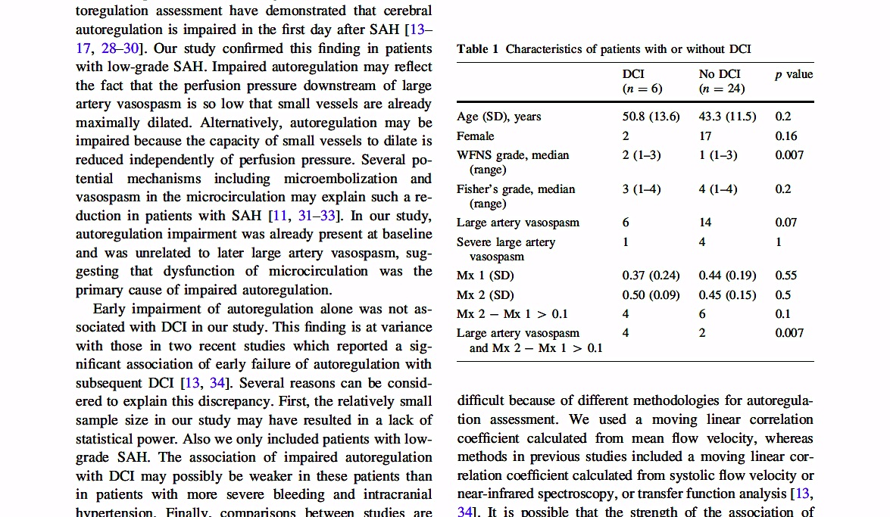
Identifying high risk VS:
by Hemodynamic Reserve?
A few studies have shown that early impairment of cerebral autoregulation is associated with DCI after SAH
Stroke 2012;43(12):3230–7; J Neurosurg 1980;53(3):305–8; Neurosurgery 2000;47(4):819-25; J Neurosurg 2001;95(3):393–401; Stroke 2007;38(3):981–6
Neurocrit Care 2015;23:253-8

Slide 19
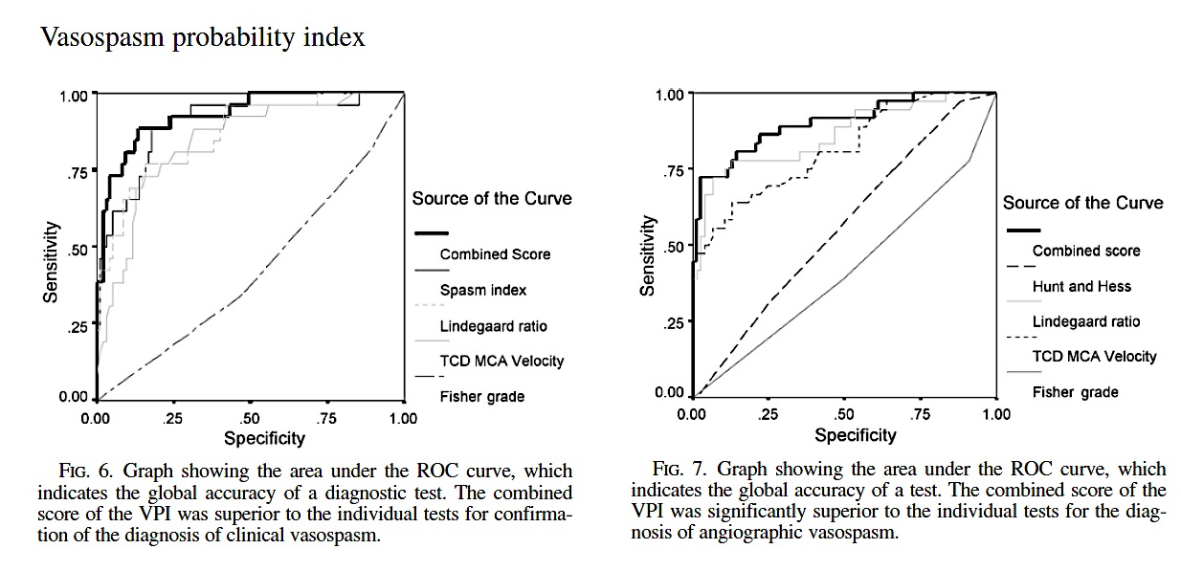
Identifying high risk VS: by Probability Index ?
VPI: combination of transcranial US velocities, cerebral blood flow, and clinical risk factors: significantly superior accuracy compared with the independent tests
J Neurosurg 107:1101–1112, 2007

Slide 20
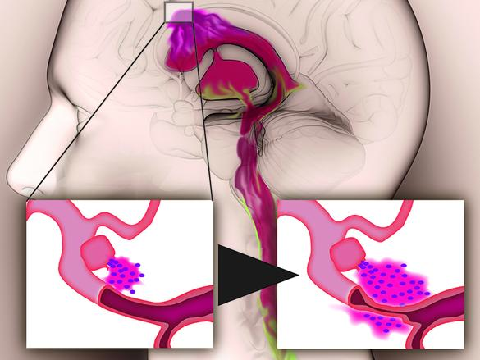
Identifying variables that might help in predicting DNID/DCI is clinically important to allow timely implementation of appropriate treatment*.
* Nimodipin, Triple H (Hypertension, Hypervolemia, Hemodilution), verapamil, statins, magnesium, lumbar drainage, endovascular: i.a. nimodipin, PTA…

Slide 21
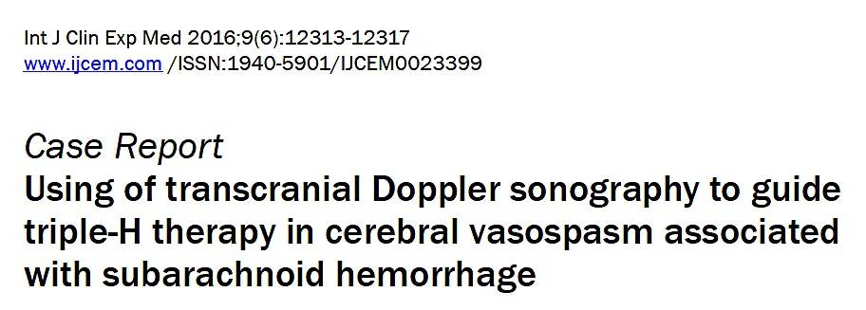

Slide 22
METHODS
Consecutive non randomized study.
patients admitted in a primary neurosurgical referral center suffering from acute aSAH as diagnosed with CTA/DSA.
systematic monitoring of the using transcranial ultrasound from baseline (day1) every 24-48h over 15-21 days.
All the patients underwent clinical assessment at baseline, onset of vasospasm and after treatment using the NIH stroke scale (NIHSS).
VS onset and severity were recorded using the indexes and/or CBFV changes.
Ttt onset (nimodipin, i-a vasodilatation, mechanical angioplasty) and clinical outcome were compared.
Clinical outcome was evaluated at discharge and at 2 months.

Slide 23
TCU Monitoring: Protocol
Day 0-1: Baseline:
VSP?
YES NO
Every 24h At 48h
LI<3 or *(CBFV changes) every 48h LI<3 * every 48h
LI≥3 * every 24h LI≥3 * every 24h
Until 48h VS free or ~15 days
Notes:
23

Slide 24
N=80 patients (54 women; mean age 53.4 yrs)
“Temporary” Delayed Neurological worsening
No deficits
N=58 **
N=22
Vasospasm
Hydrocephalus/other
N=50
N=8
Treatment started at
symptom onset
N=21
N=29
N=4
n=17
N=21
N=8
Reversible*
NIHSS=0
Persistent
Reversible*
NIHSS=0
Persistent
*Immediate treatment upon Lindegaard > 3 is associated with a higher likelihood of symptom reversal (Fisher Exact p<0.0005 2-tailed).
DSA (performed in >2/3 of the patients ) showed a 100% agreement in the diagnosis of VS

Slide 25
Conclusions
TCU monitoring of VSP according to a standardized protocol should be performed by experimented & motivated examiners
TCU monitoring may be a useful tool to guide treatment decisions and may thus contribute to long-term clinical improvement when treatment is rapidly initiated.
Comprehensive TCCS evaluation is a useful bed-side tool for the monitoring of intracranial hemodynamic changes.
Notes:
25

Slide 26

Thank you for your attention
ありがとう

